Slide 1
Walker River Irrigation District
Reservoir Operation Scenarios
Board of Directors Meeting, April 7, 2017

Slide 2
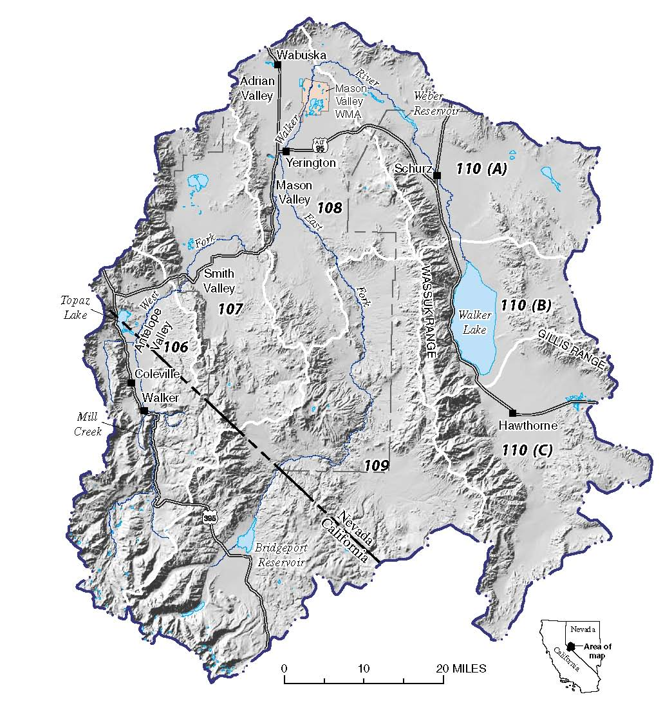
Overview
Exceedance Forecasts
Historical Context
Bridgeport Operations
Topaz Operations
Downstream Flows
Questions

Slide 3
Exceedance Forecasts
California Nevada River Forecast Center and others

Slide 4
Exceedance Forecasts Available
Natural Resources Conservation Service
California Department of Water Resources
California Nevada River Forecast Center
Updated on a daily basis
Provide forecast data on a daily time step

Slide 5
April – July Forecast Comparison
Exceedance | CNRFC | NRCS | DWR Bulletin 120**
East Walker River near Bridgeport
90% | 175 TAF | 126 TAF* | --
50% | 193 TAF | 164 TAF* | 175 TAF
10% | 222 TAF | 200 TAF* | --
West Walker River below Little Walker near Coleville
90% | 372 TAF | 290 TAF | --
50% | 391 TAF | 330 TAF | 300 TAF
10% | 431 TAF | 370 TAF | --
*NRCS forecast for East Walker River near Bridgeport is for April-August
**March 1 Bulletin 120 forecasts

Slide 6
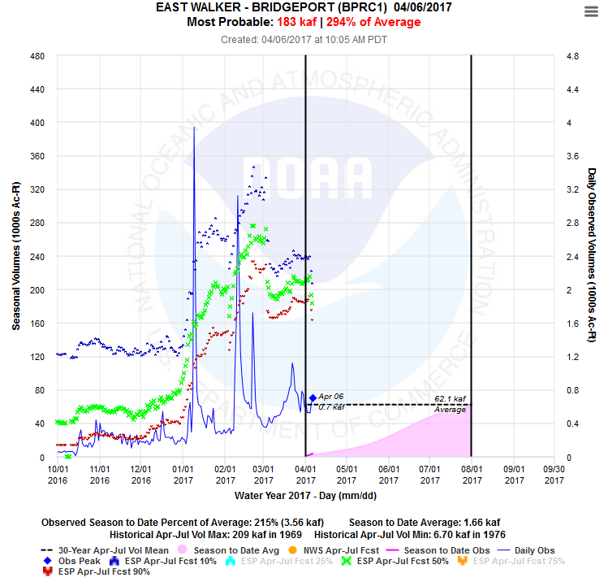

Slide 7
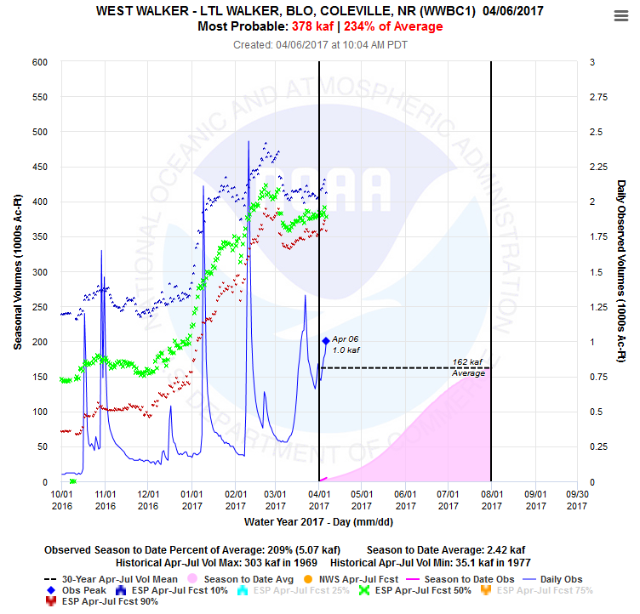

Slide 8
Bridgeport Scenarios
2014

Slide 9
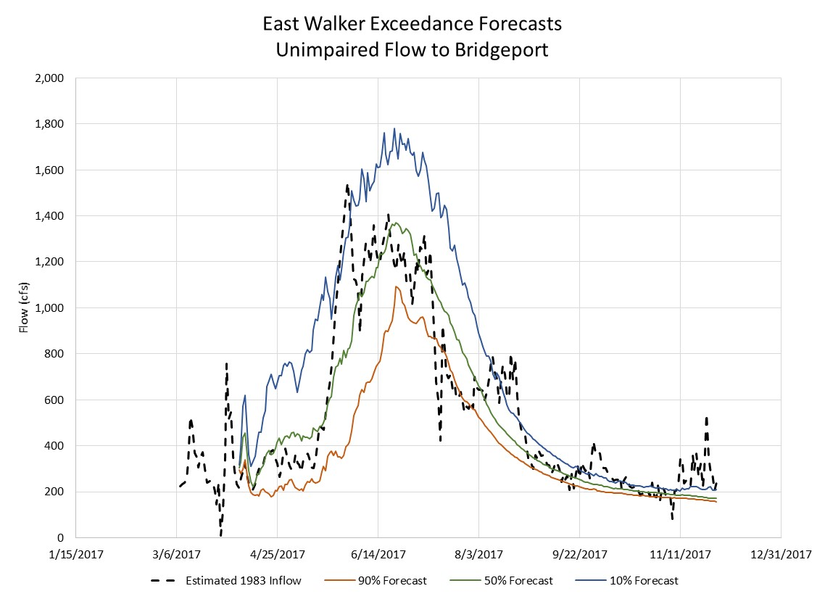
East Walker Exceedances

Slide 10
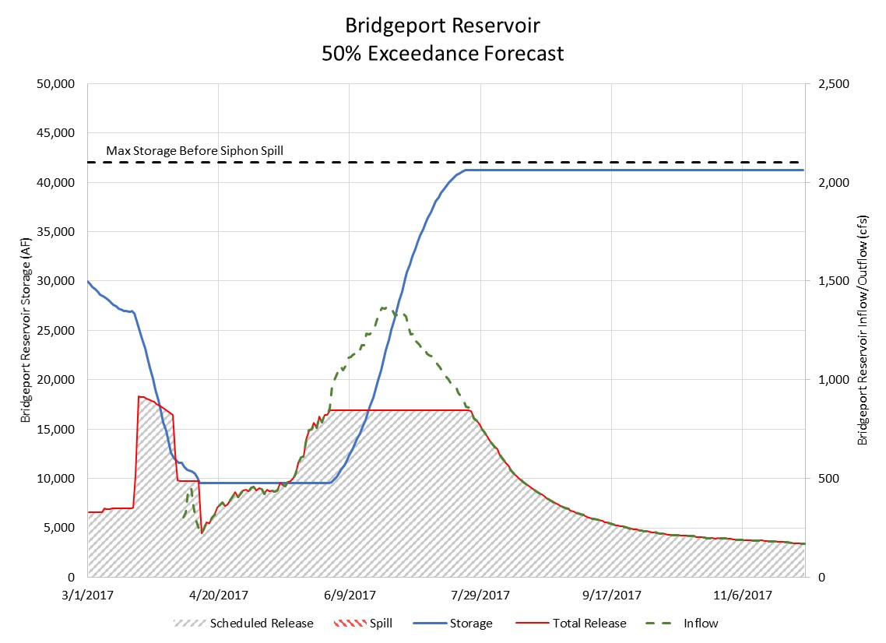
845 cfs

Slide 11
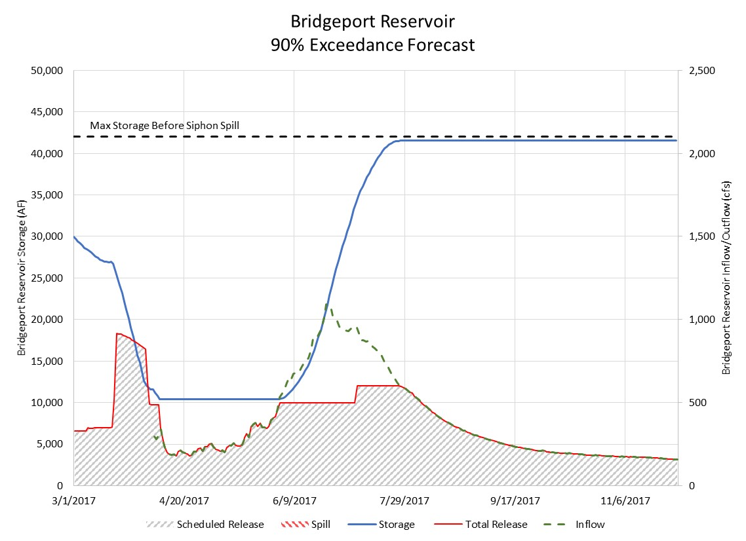
600 cfs

Slide 12
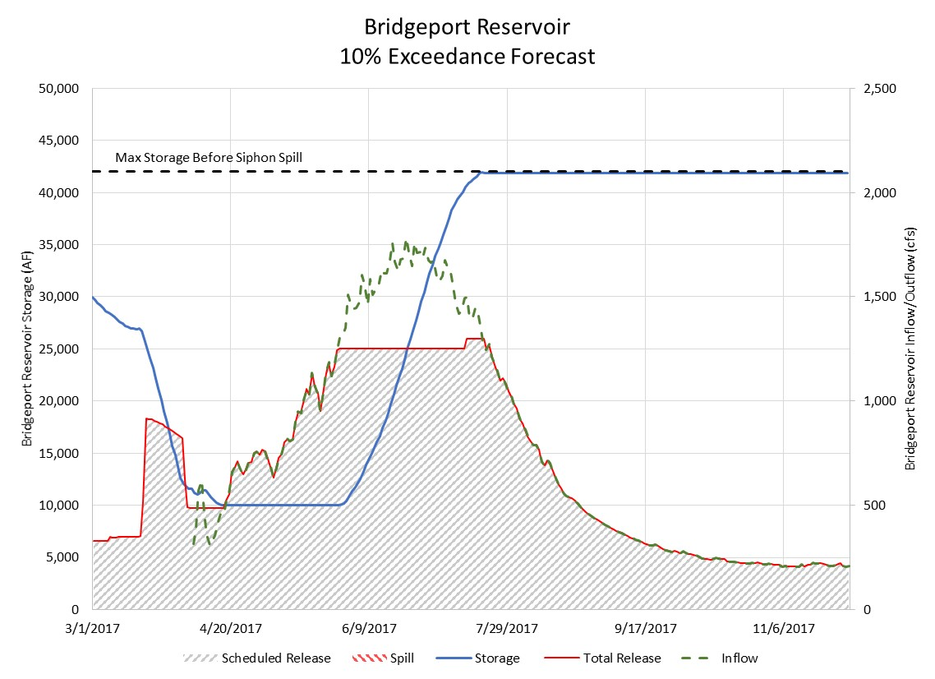
1,300 cfs

Slide 13
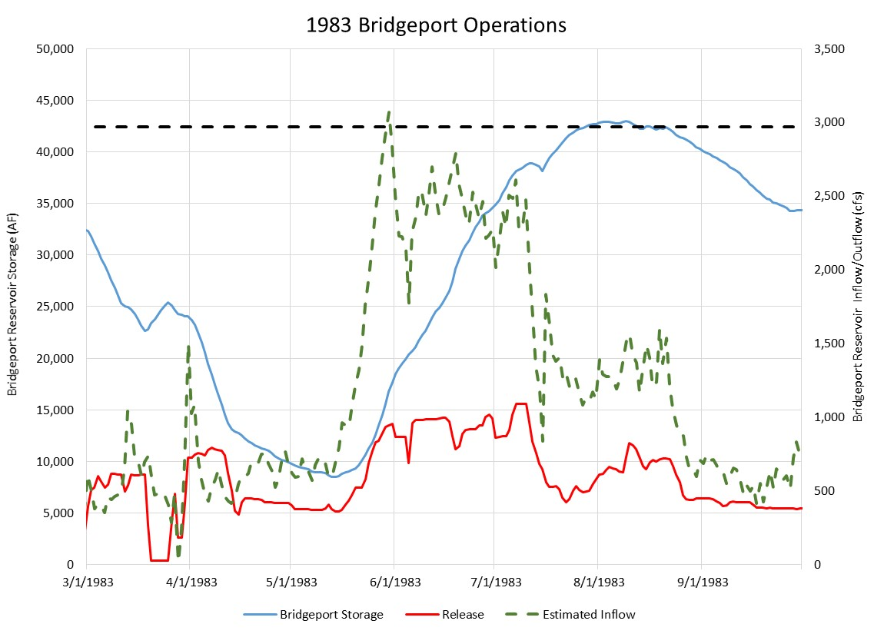

Slide 14
Topaz Scenarios
2015

Slide 15
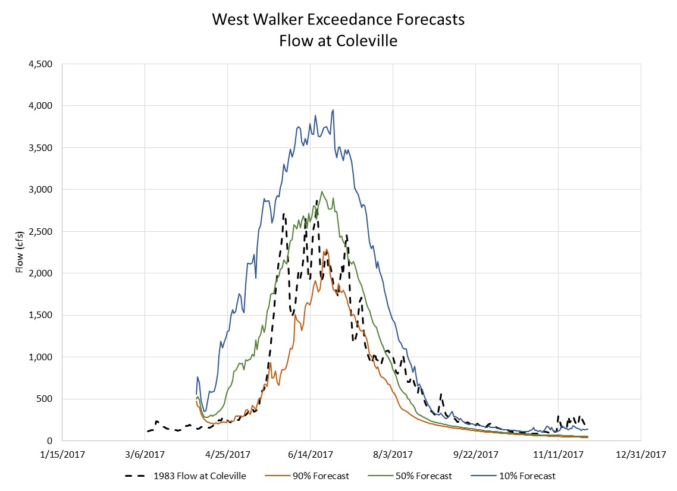
West Walker Exceedances

Slide 16
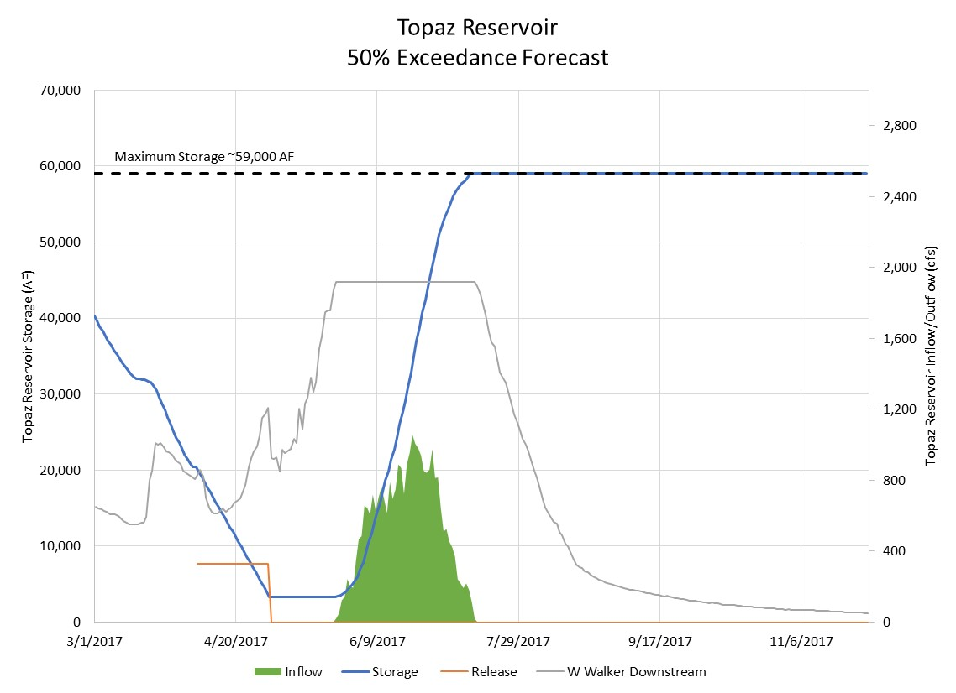
1,920 cfs

Slide 17
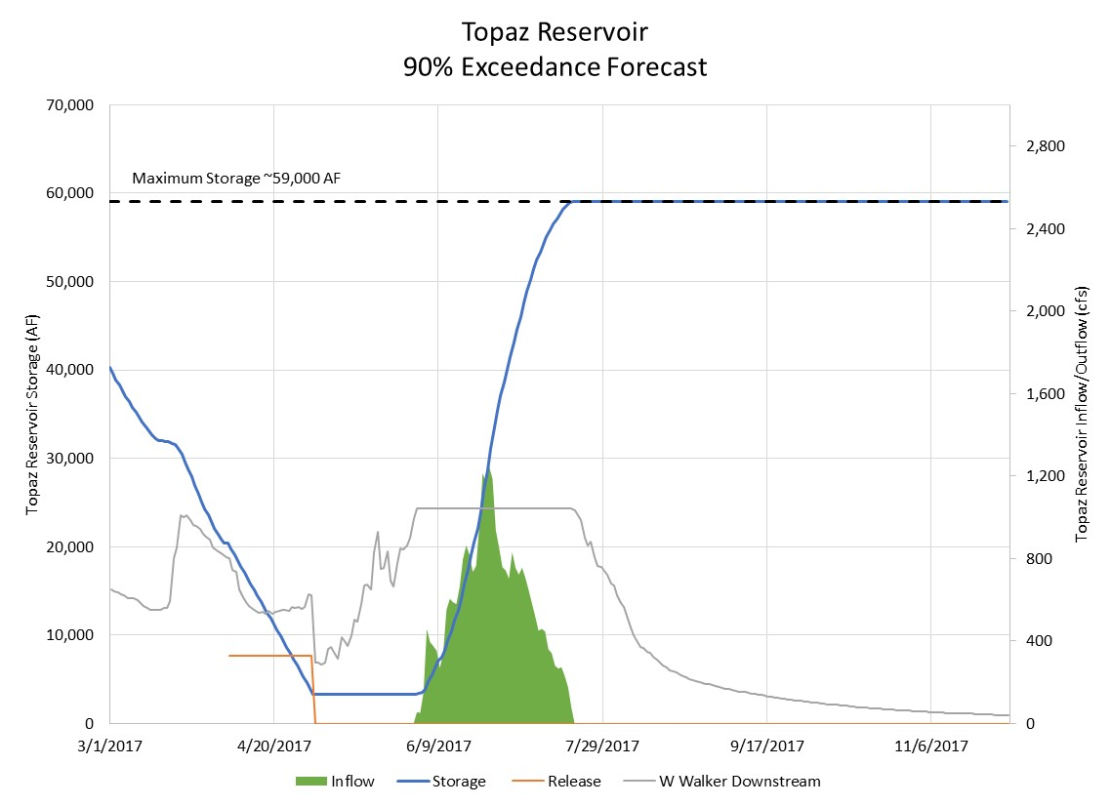
1,045 cfs

Slide 18
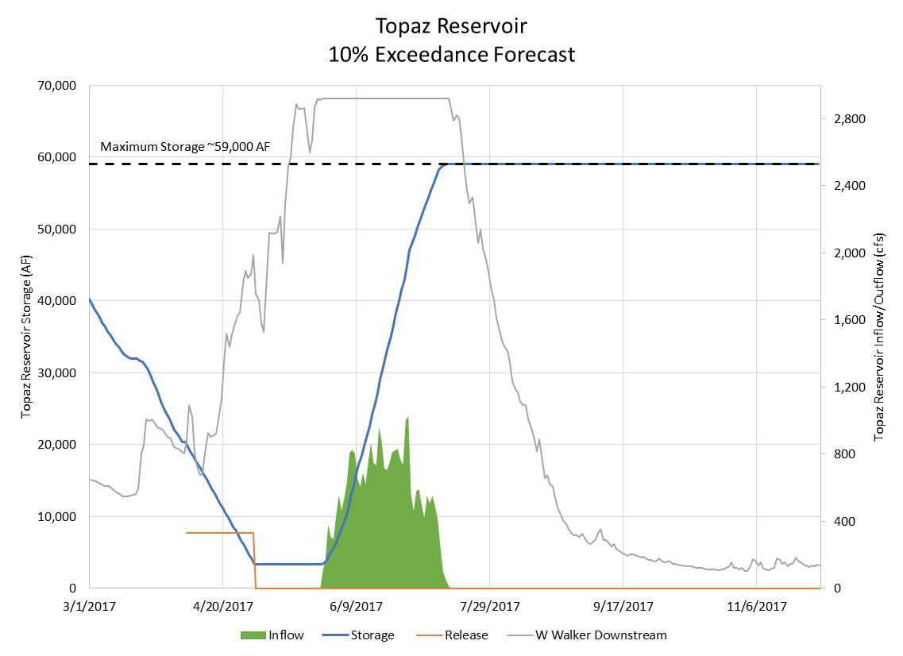
2,920 cfs

Slide 19
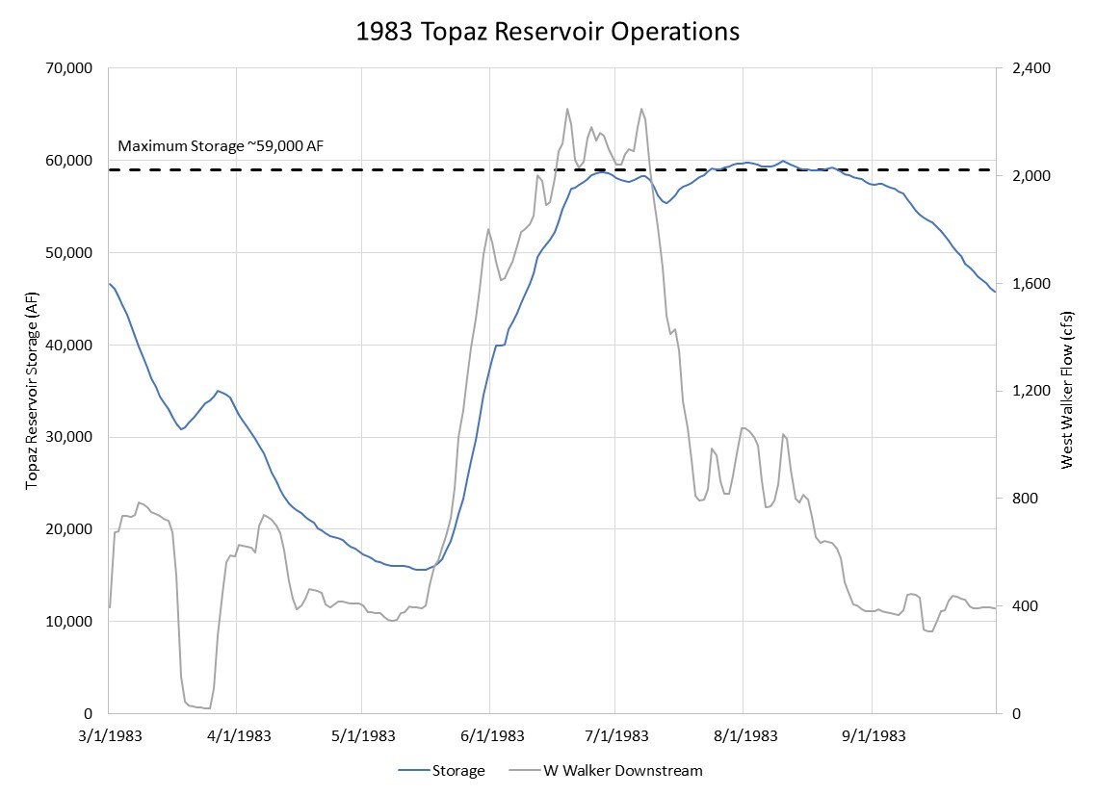

Slide 20
River Flow Scenarios

Slide 21
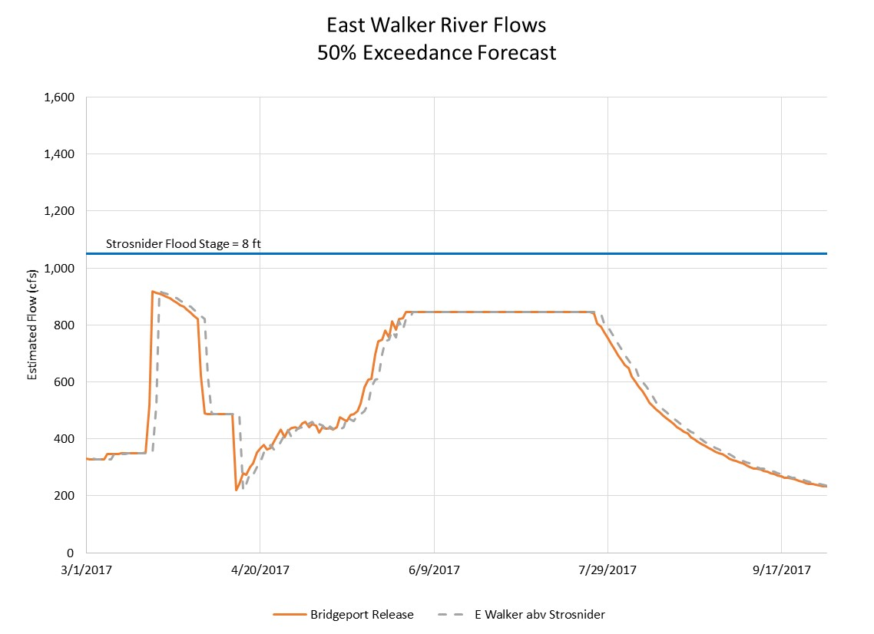

Slide 22
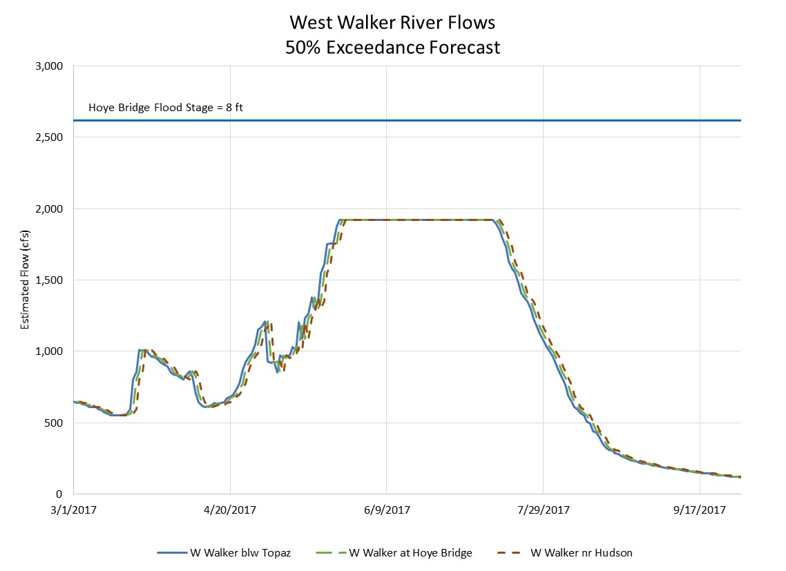

Slide 23
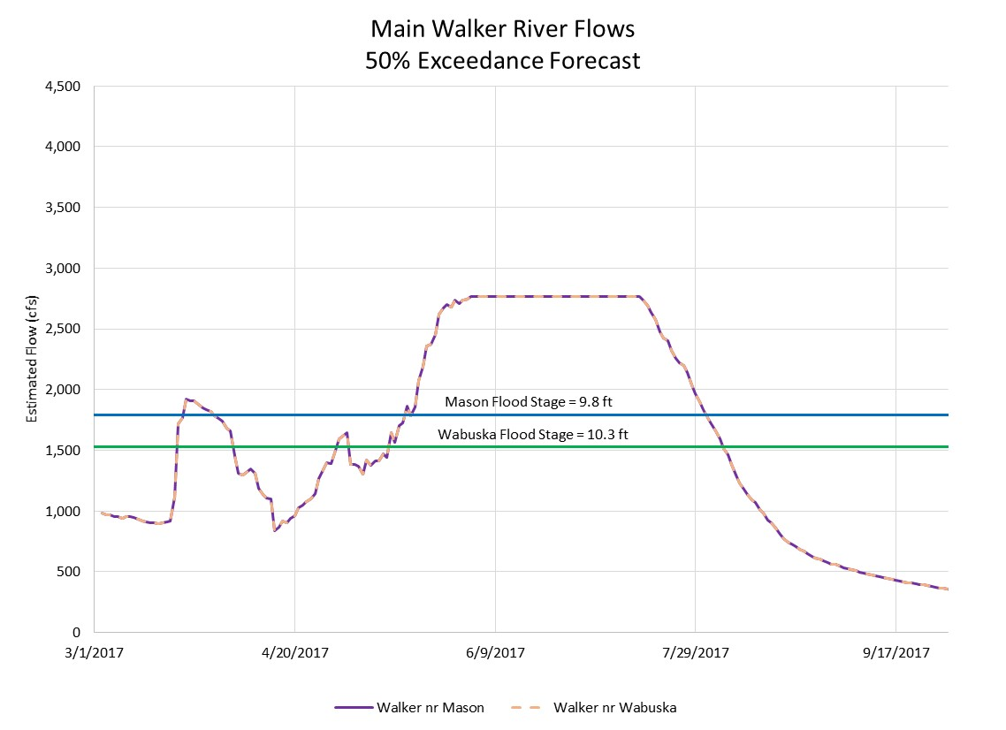

Slide 24
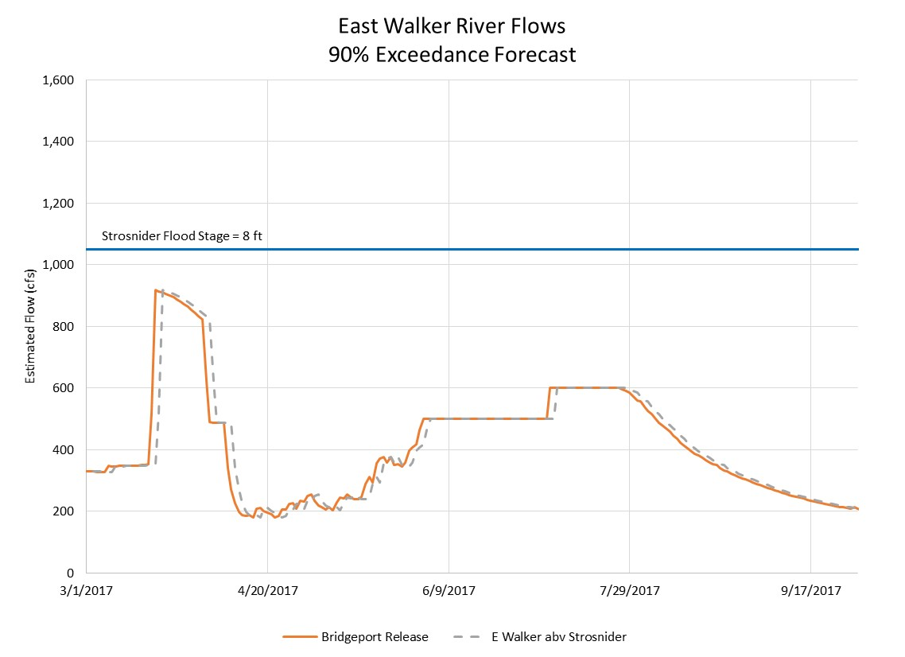

Slide 25
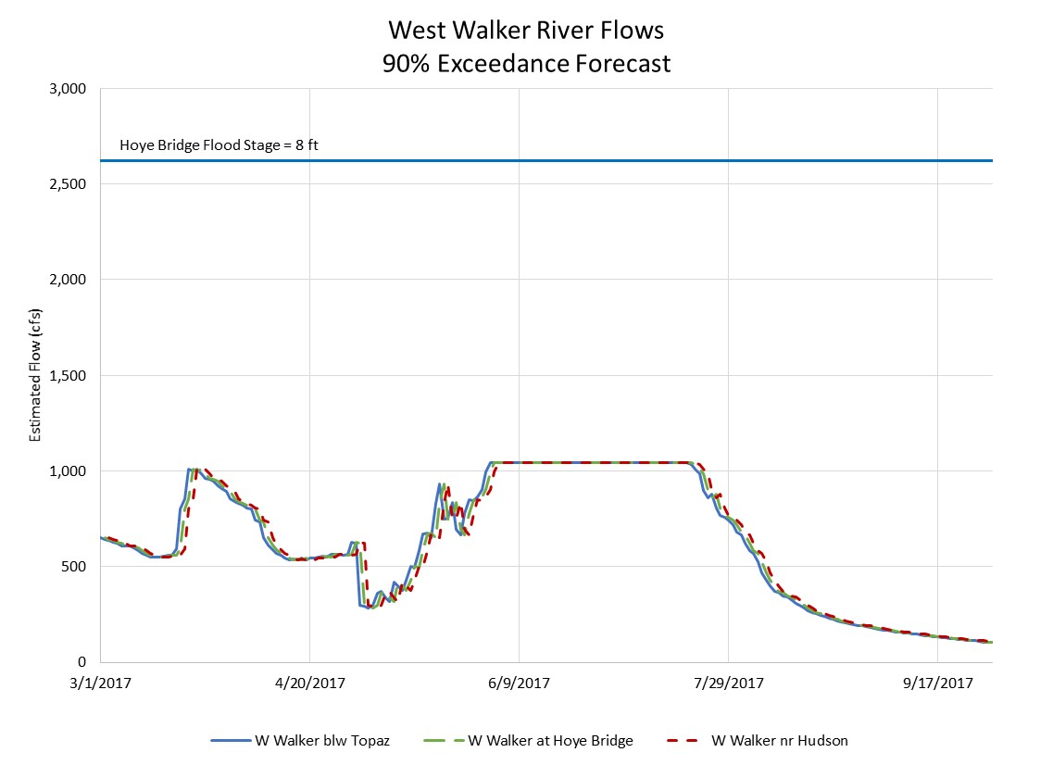

Slide 26
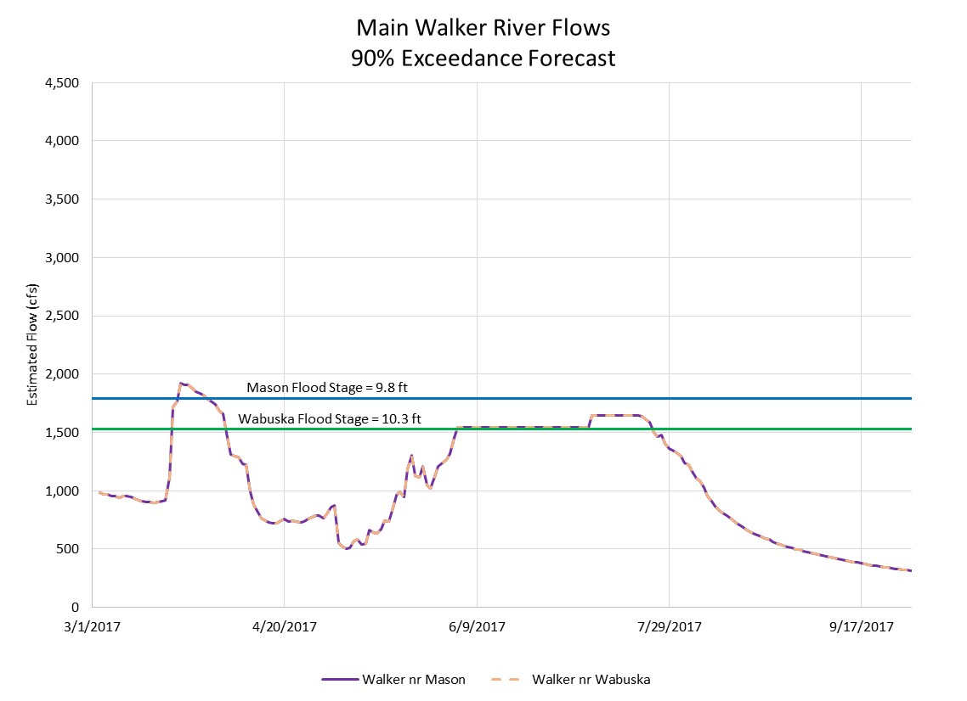

Slide 27
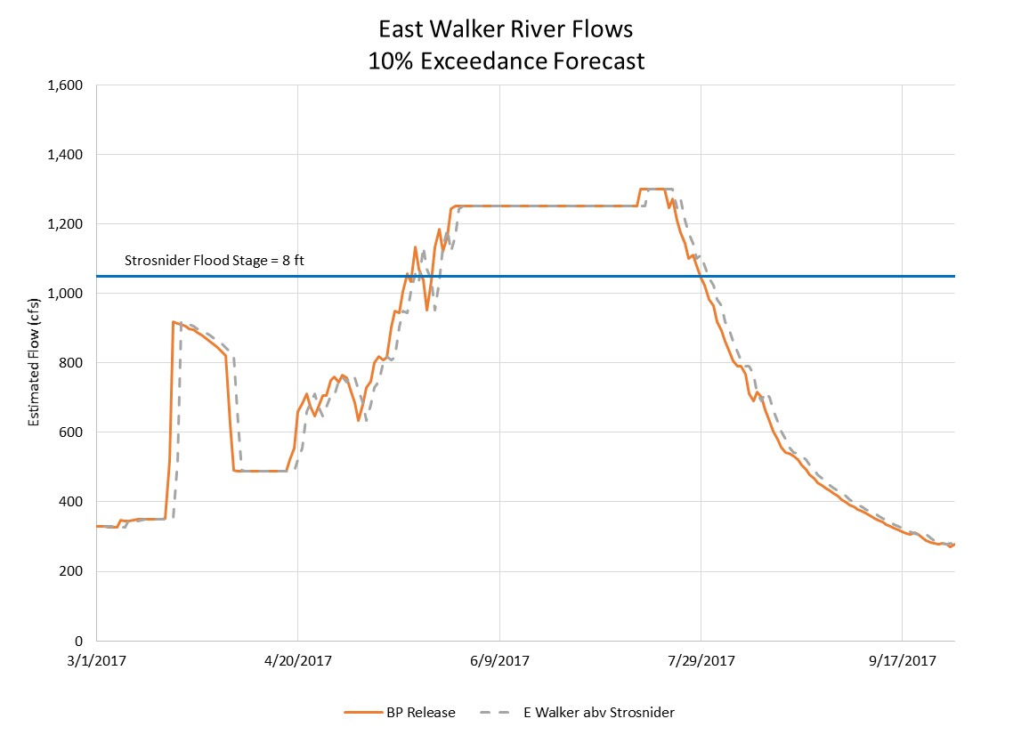

Slide 28
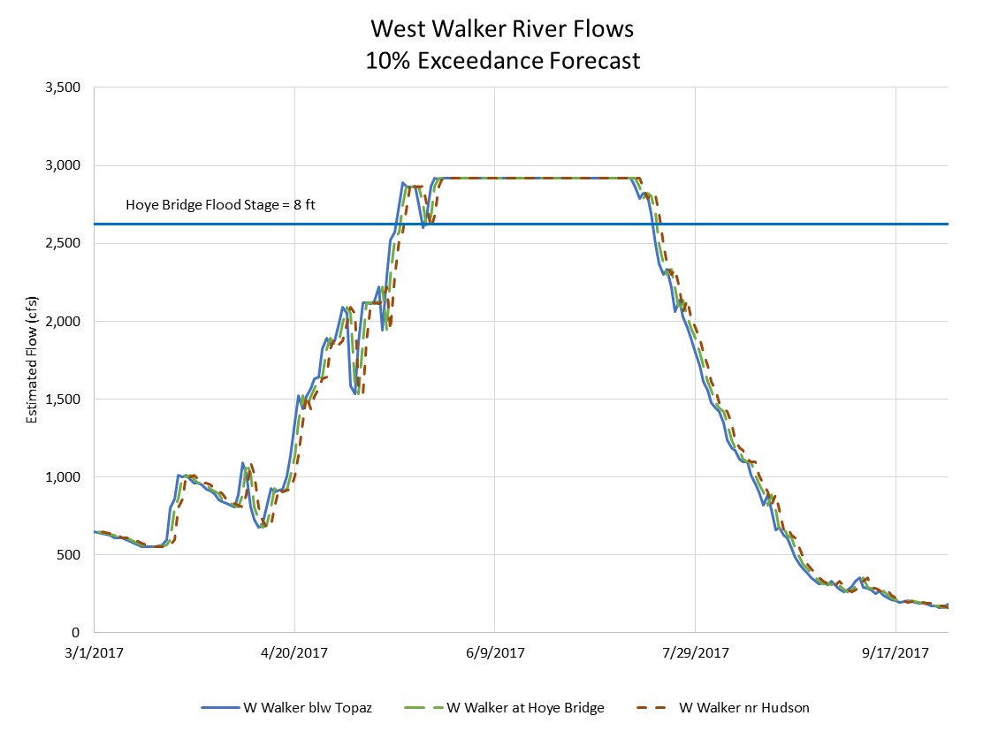

Slide 29
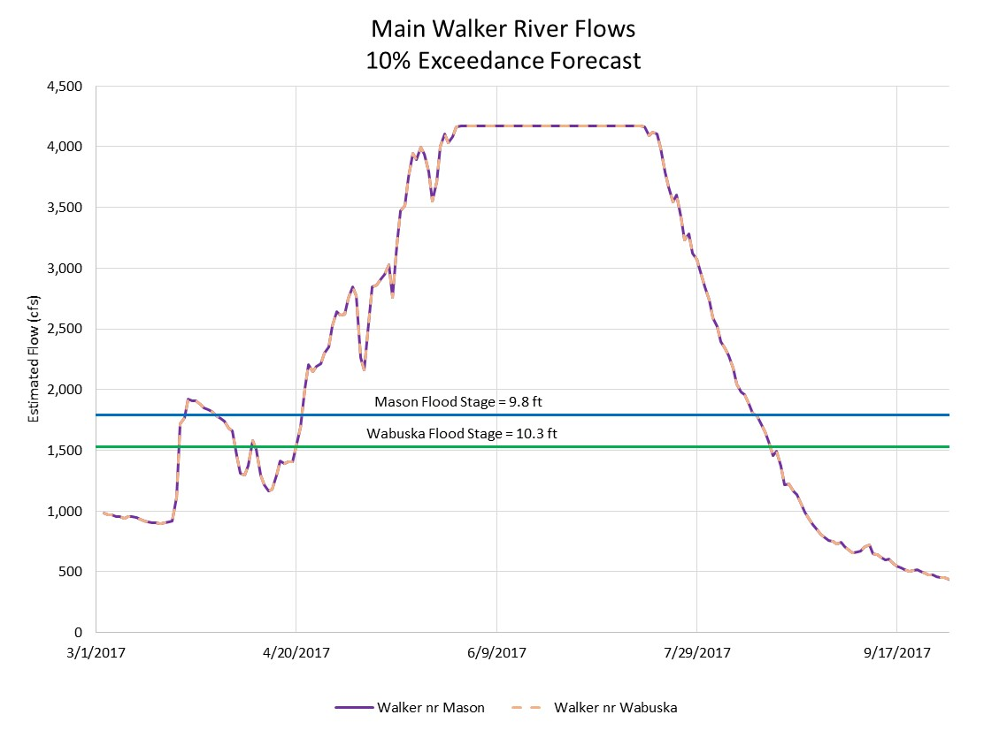

Slide 30
Peak Flow Summary
Location | 90% Forecast | 50% Forecast | 10% Forecast
East Walker River | 600 | 845 | 1,300
West Walker River | 1,045 | 1,920 | 2,920
Walker River | 1,645 | 2,765 | 4,170

Slide 31
Conclusion
Effective reservoir management will help downstream conditions
Monitoring of conditions and adaptive management are required
The 50% Exceedance Forecasts conditions result in flows and operations similar to 1983

