Slide 1
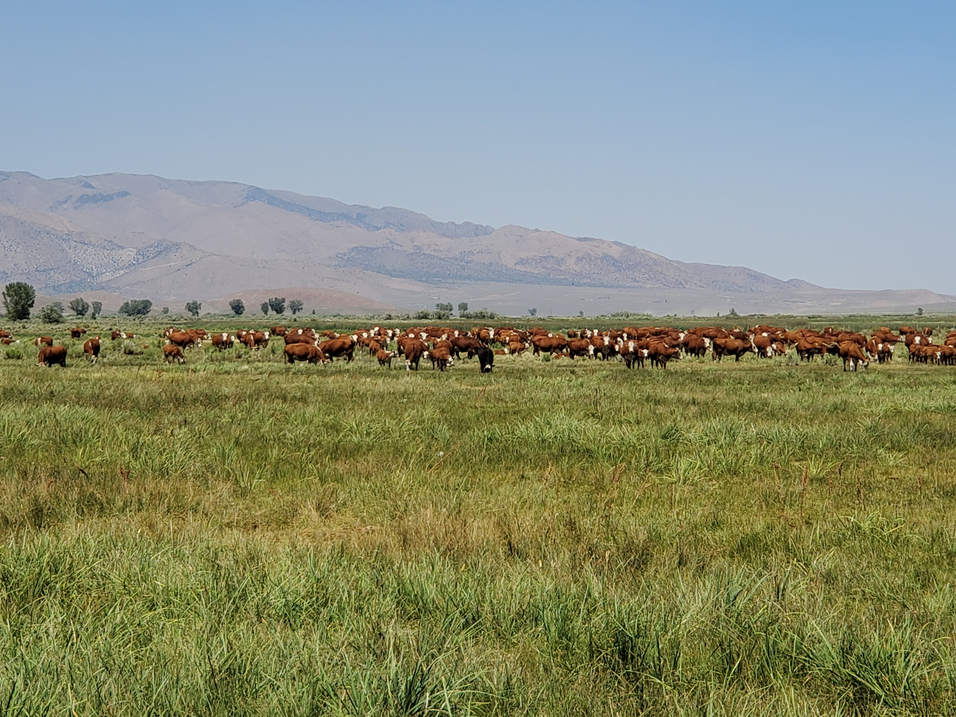
Walker River Ranch LLC 1921 WRID Easement

Slide 2
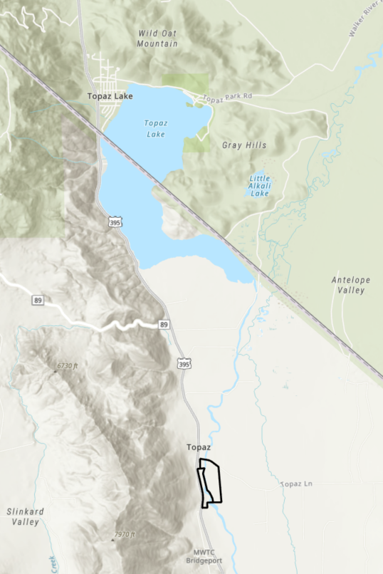
Property Overview
Mono County, CA
West - Hwy 395
North - Topaz Lane
~1 mile stretch of West Walker River

Slide 3
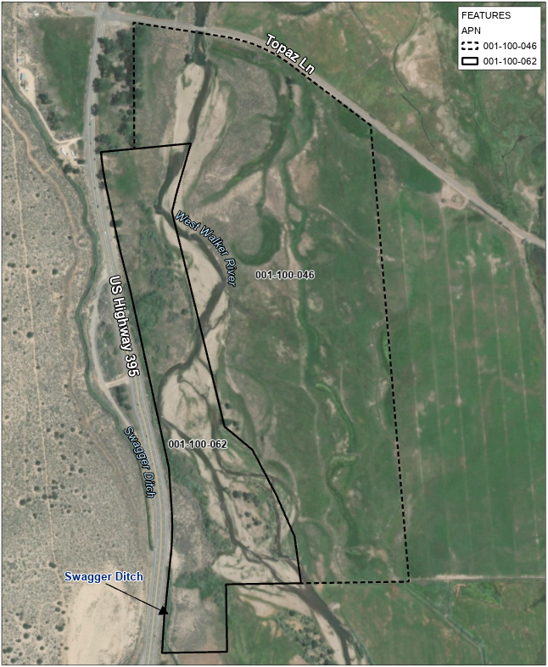
Property Overview
~136 acres
Land use - livestock grazing
Bank instability, erosion require restoration (native vegetation planting)
Will improve water quality

Slide 4
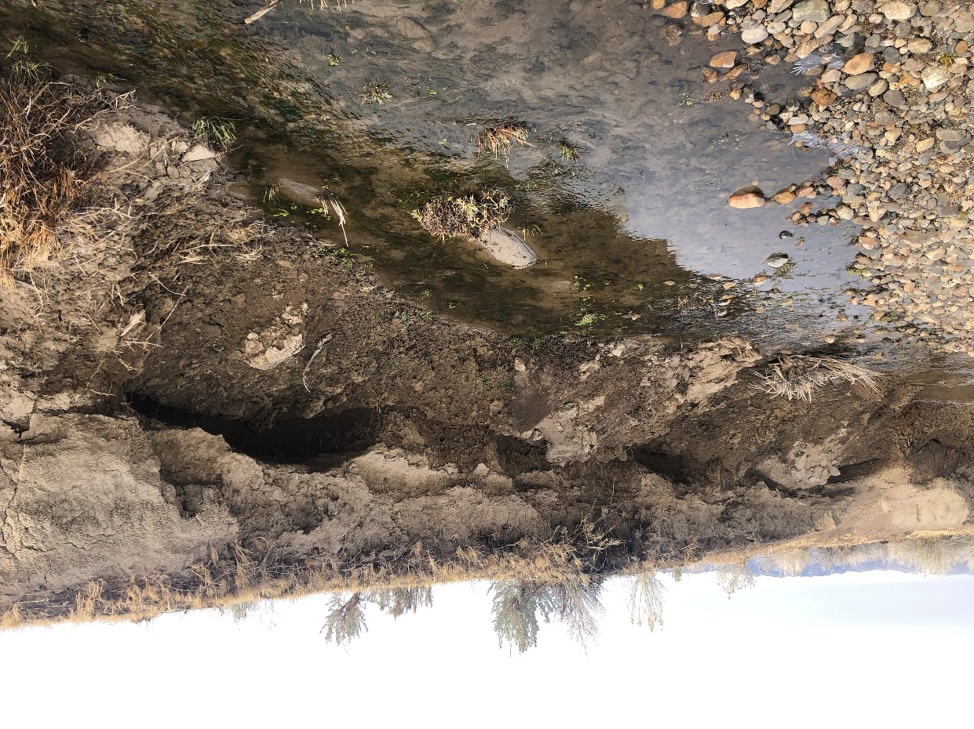
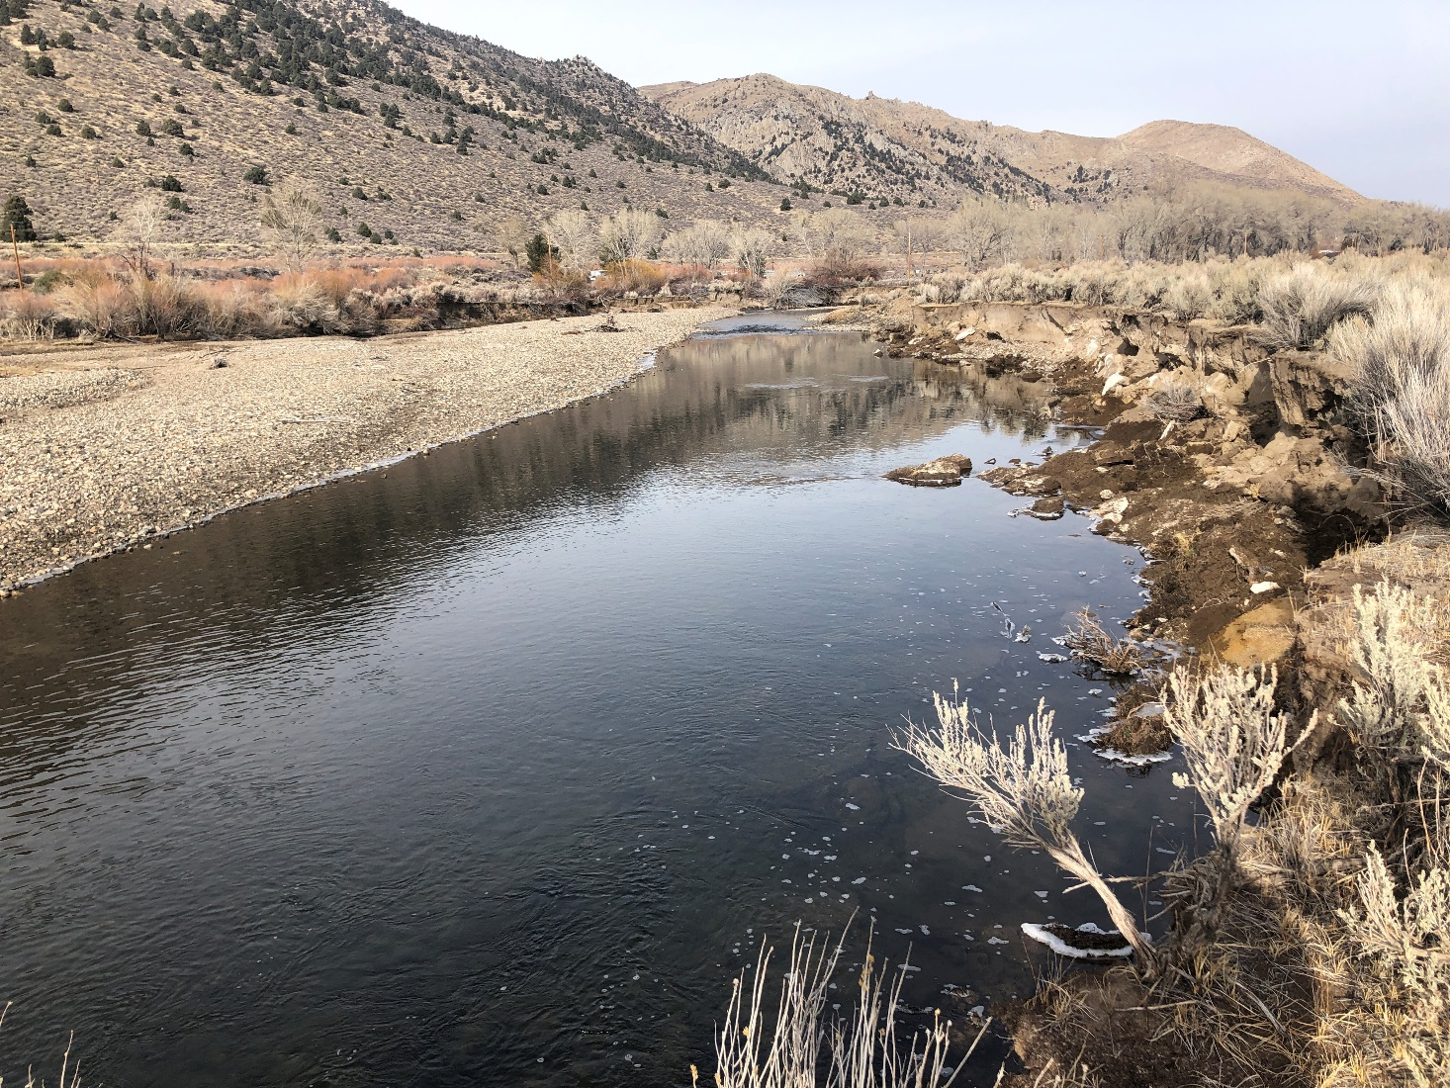
Native Vegetation Prevents/Repairs Streambank Erosion and Improves Water Quality

Slide 5
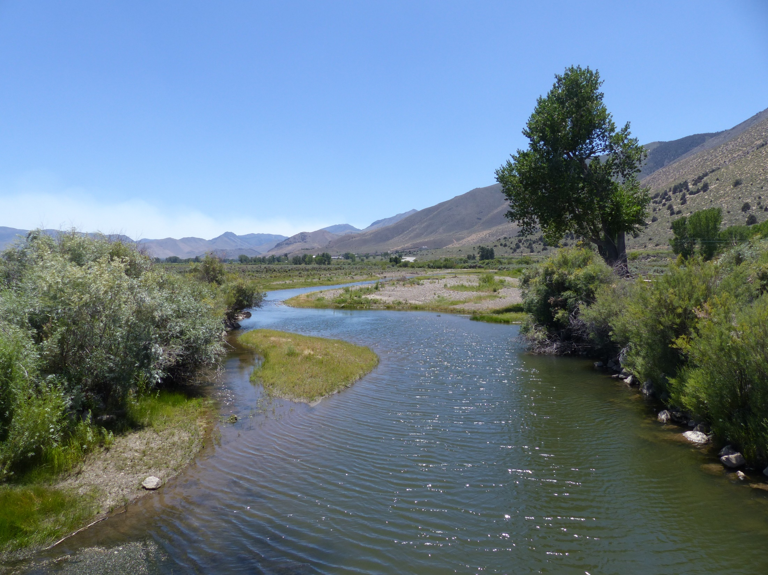
Pasture and Riparian Restoration Plan
Bank-stabilizing willows, cottonwoods
Reduce erosion and irrigated pasture loss
Improve water quality
Improve livestock carrying capacity

Slide 6
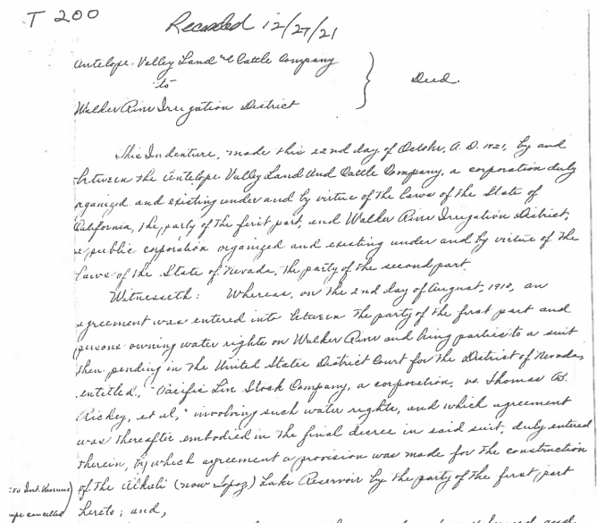
1921 Easement Provided WRID With Two Options
Construct new inlet on west bank of West Walker River in SW¼ of SW¼ Sec 24 and build a canal generally north through sections 24, 14, 13, 12, 2, and 1
Use the existing Swagger (Swauger) Ditch

Slide 7
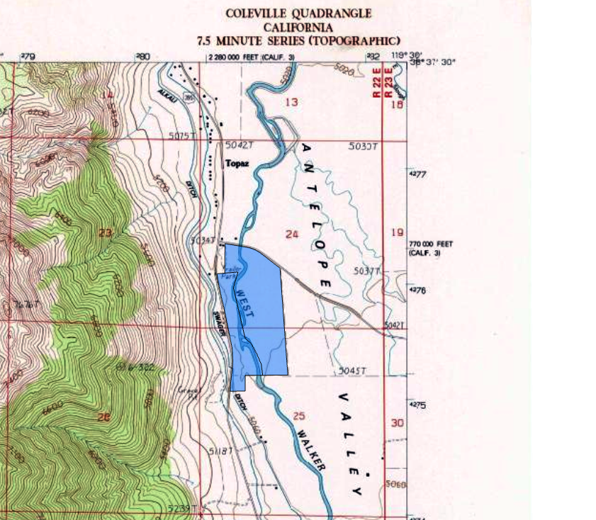
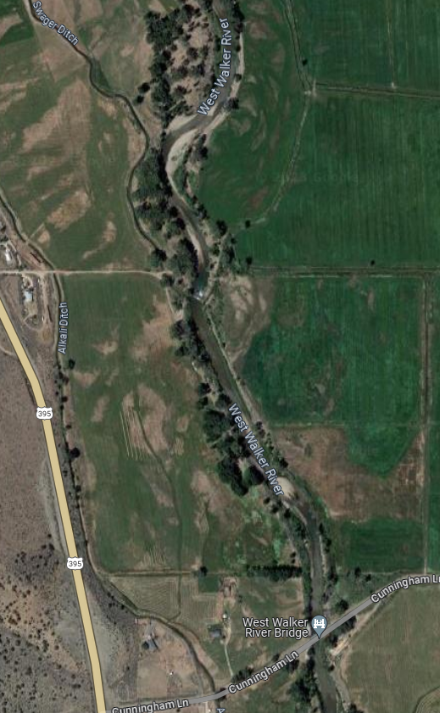

Slide 8
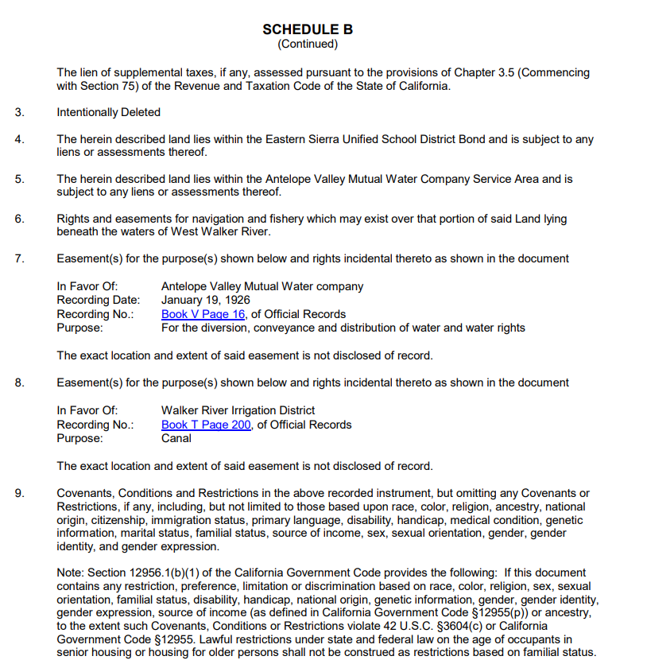
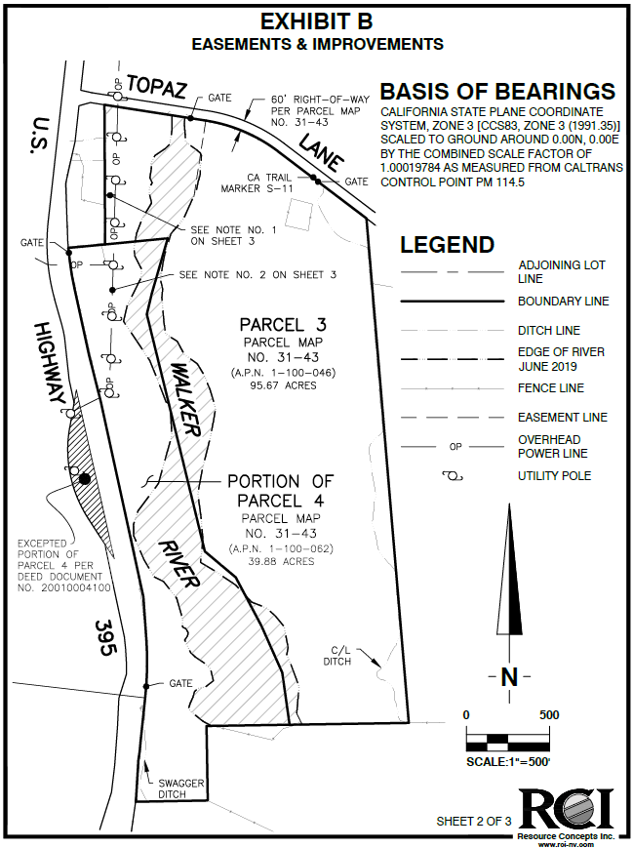
Remnant of 1921 WRID Easement remains on title (#8) and exact location and extent can’t be plotted

Slide 9
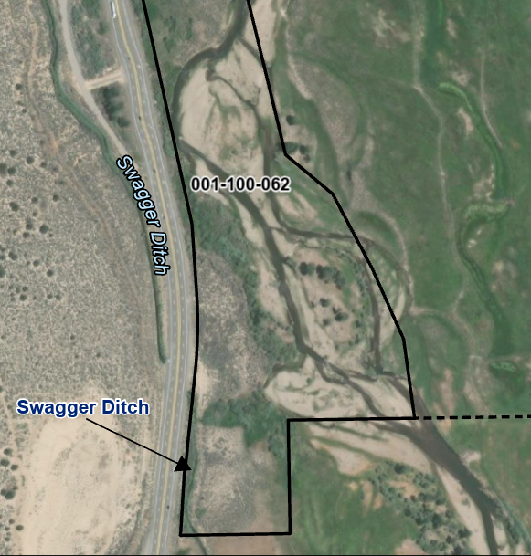
Current Conditions
WRID did not build an inlet for the Swagger Ditch in the SW¼ of SW¼ of Sec 24
WRID elected to use the existing Swagger Ditch

Slide 10
WRID Action
Letter or Resolution:
WRID activities are confined to the existing footprint of the Swagger Ditch with a 200 ft right of way (100’ on each side of the centerline of Swagger Ditch)
Acknowledgment WRID has no remaining rights in the remnant on title from the 1921 easement to construct a new intake canal on the Walker River Ranch LLC property
WRID’s existing easement and water rights are not altered or extinguished.
A necessary step in restoration planning and for the recordation of a conservation easement on a portion of the Walker River Ranch LLC property.

Slide 11
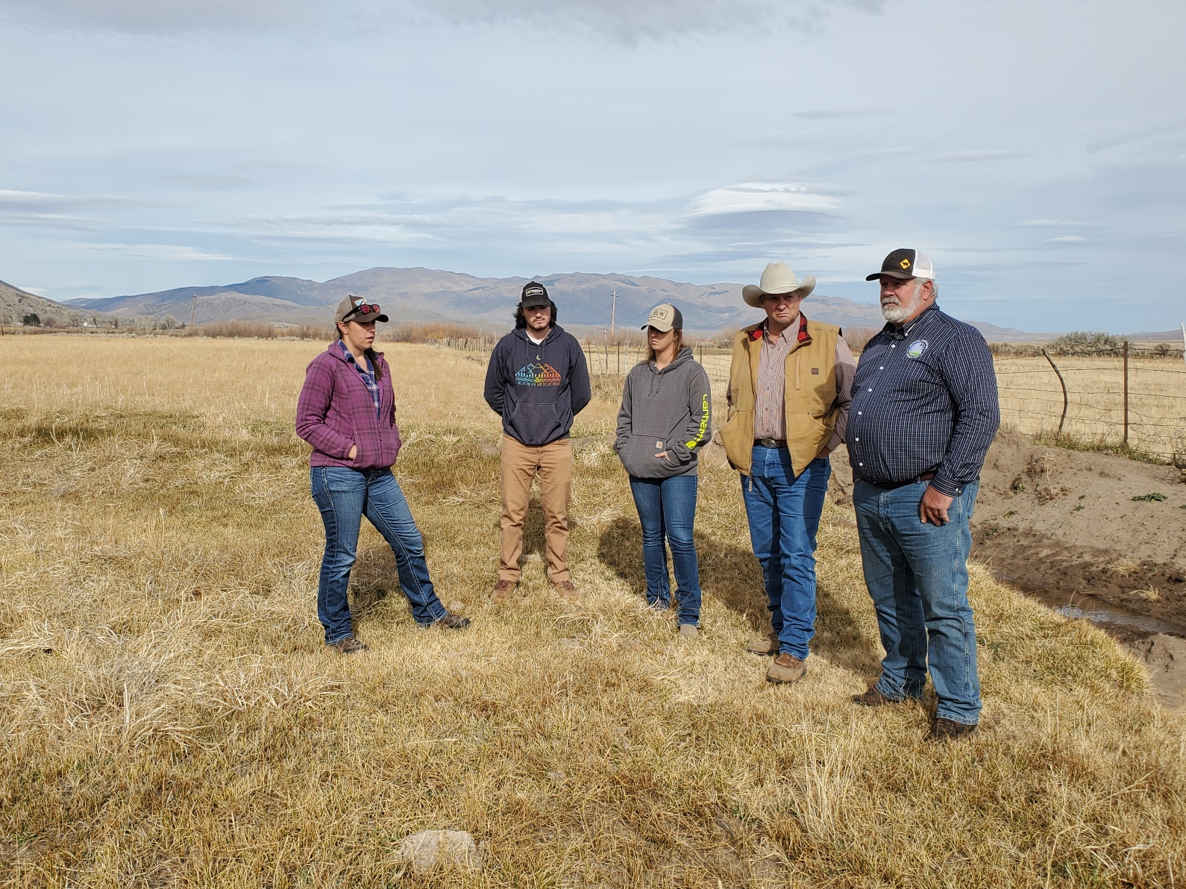
THANK YOU
ANY QUESTIONS?

