Slide 1
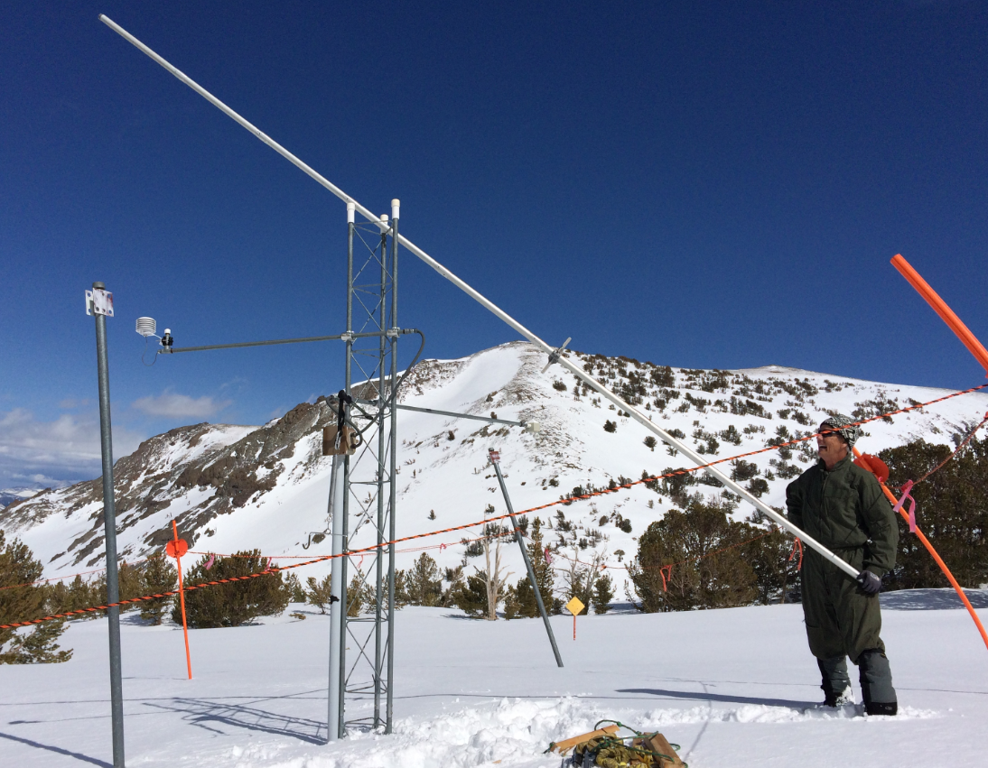
2017 Snowpack Status and
Streamflow Outlook
for Walker Basin
April 7, 2017
Walker River Irrigation District
Leavitt Lake SNOTEL, March 27, 2017
Jeff Anderson
Nevada NRCS Snow Survey
(775) 857-8500 x152
jeff.anderson@nv.usda.gov
Notes:
GO TO VIEW > MASTER > SLIDE MASTER TO EDIT THE IMAGES ON THE TITLE AND DIVIDER SLIDES

Slide 2
Key Points:
Based on April 1 SNOTEL and snow course data snowpacks in the Walker Basin are over twice normal and at, or near, record amounts.
  West Walker 212%
  East Walker 235%
  Overall 217%
Snow in Sweetwater Mtns and at lower elevations stands out, BUT… these conditions are very similar to 1983.
Walker Basin has had record precipitation in 2017 at SNOTELs.
Basin-wide soil moisture and snow pack density is ahead of schedule. A ripe snowpack may be a good thing for early runoff.
NRCS forecasts predict volumes greater than 1983 on West Walker. Forecast are less than 1983 on the East Walker.

Slide 3
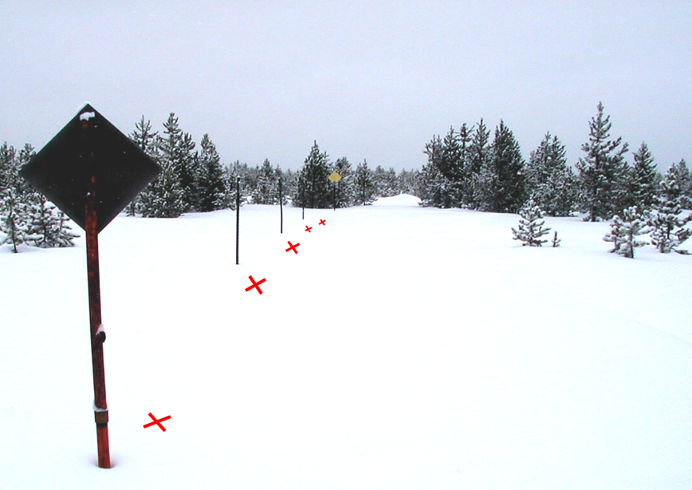
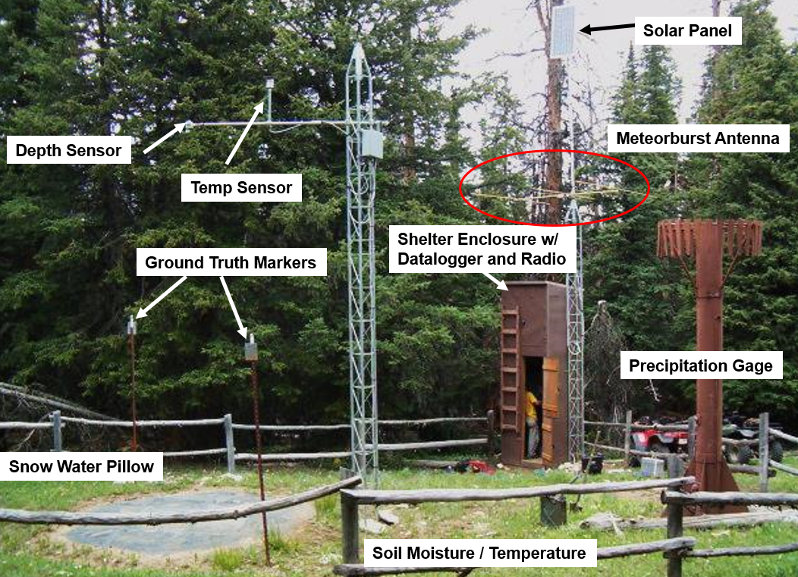
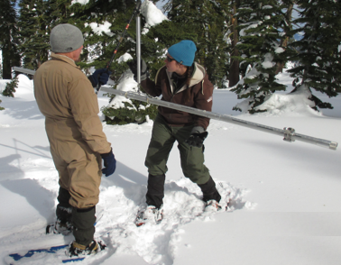
NRCS Monitoring Network
SNOTEL Stations
automated weather station
with snow pillow
Snow Courses
snow tube transect

Slide 4
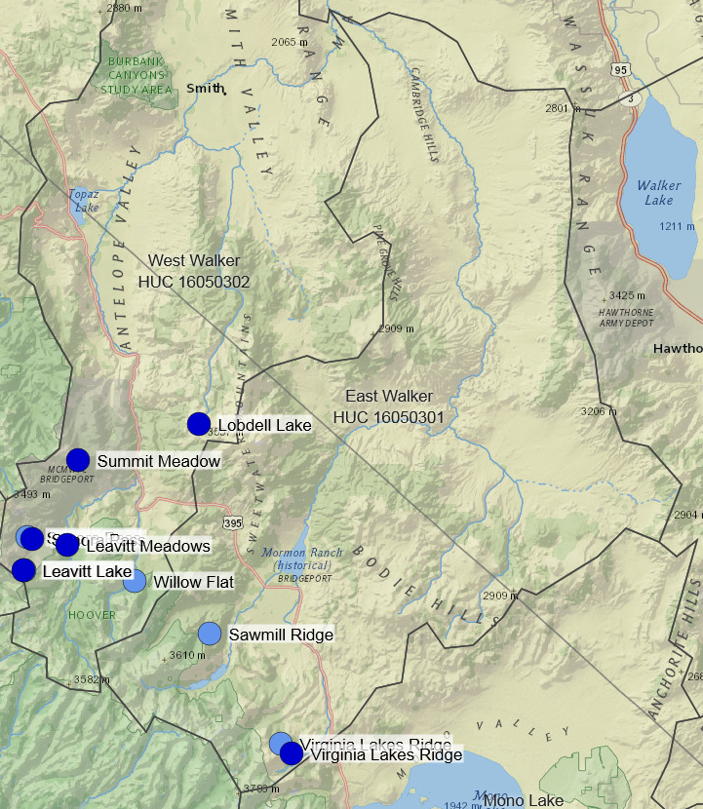


Sonora Pass SNOTEL
& Snow Course
Virginia Lakes Ridge SNOTEL & Snow Course

Slide 5
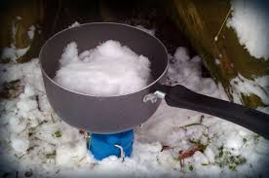
SWE definition
Snow Water Equivalent (SWE) is the amount of water contained within the snowpack. It can be thought of as the depth of water that would result if you melted the entire snowpack.

Slide 6
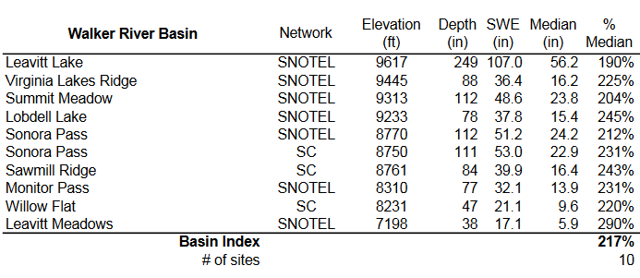
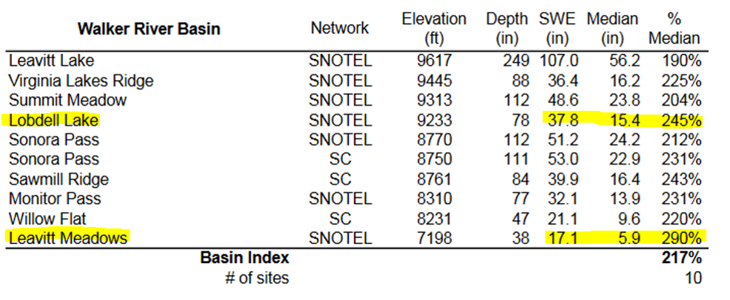
Walker Basin Snowpack Summary
April 1, 2017

Slide 7
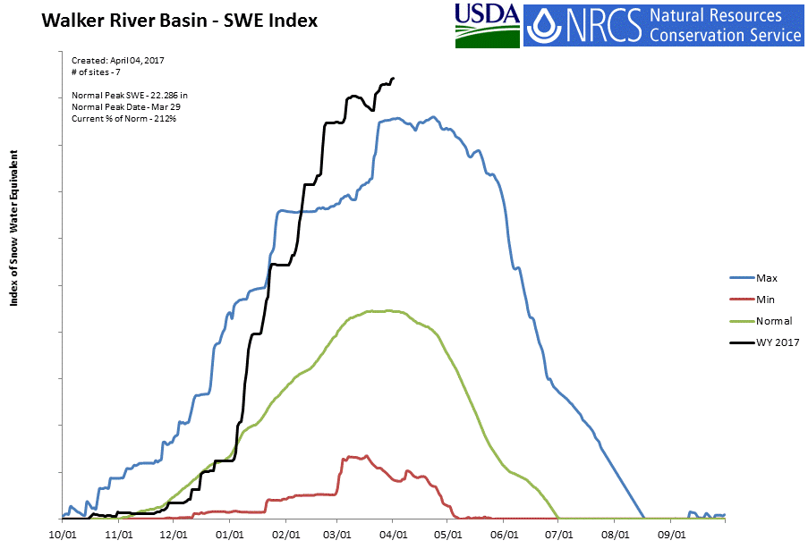
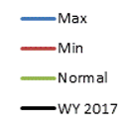

Slide 8
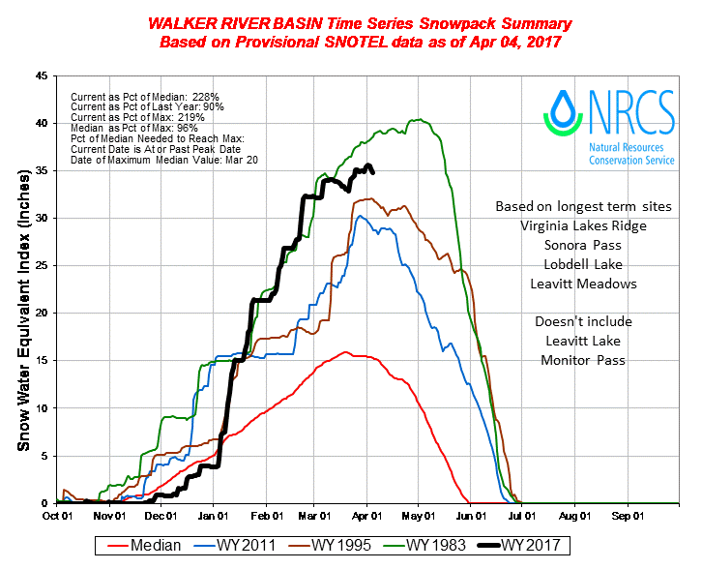
(1989)
(1990)

Slide 9
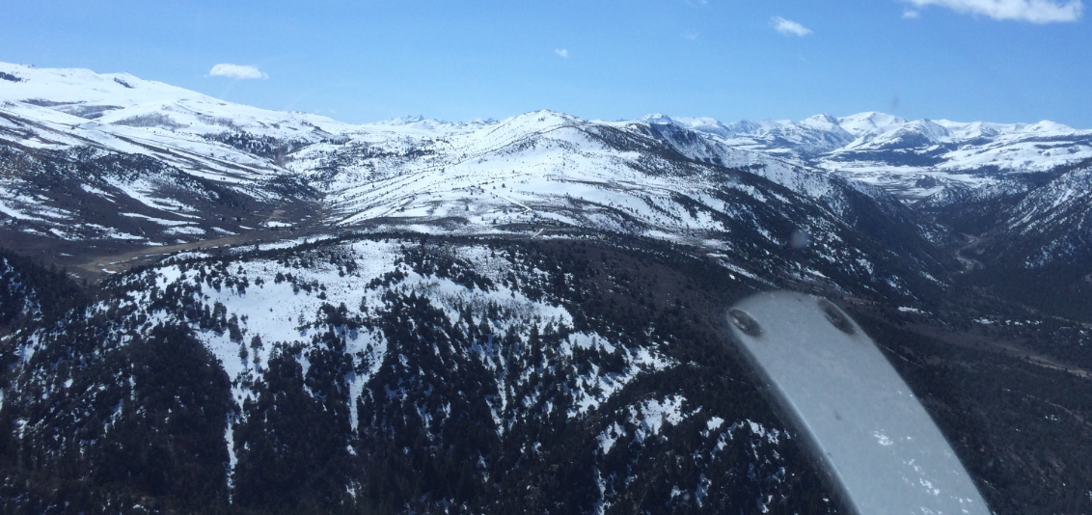
Sweetwater Mountains 3/27/2017

Slide 10
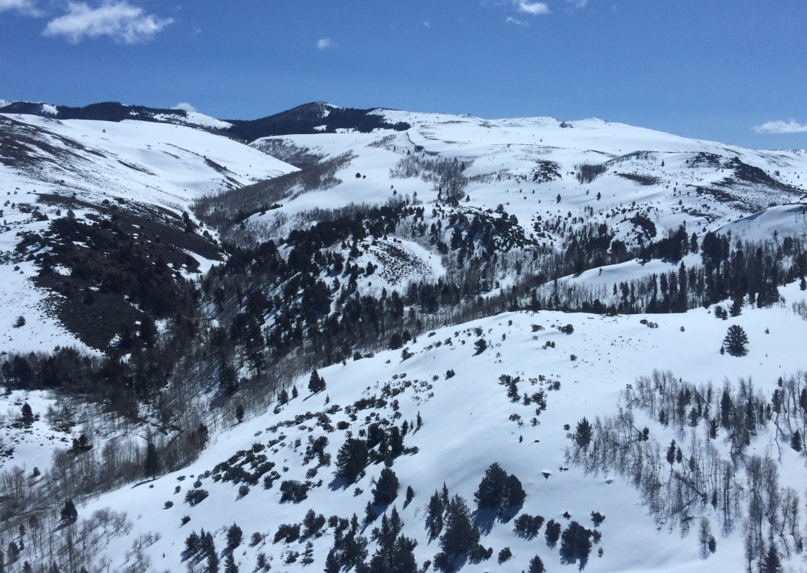
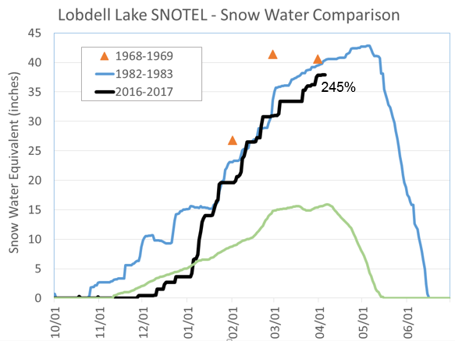
Sweetwater Mountains 3/27/2017

Slide 11
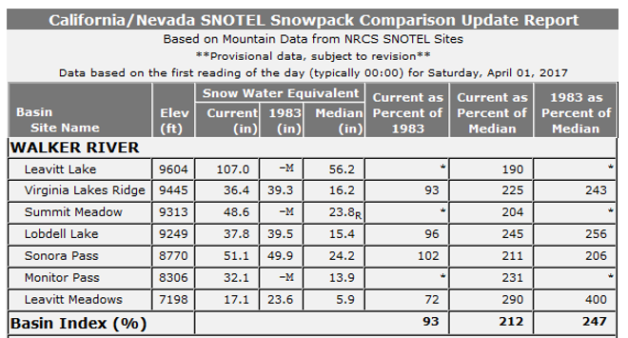
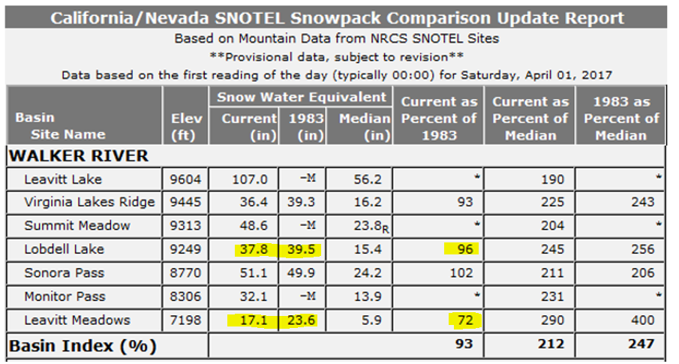
108.0*
99
190
96
221
*Leavitt Lake 1983 data back estimated from regression with snow course, excellent correlation R² = 0.95

Slide 12
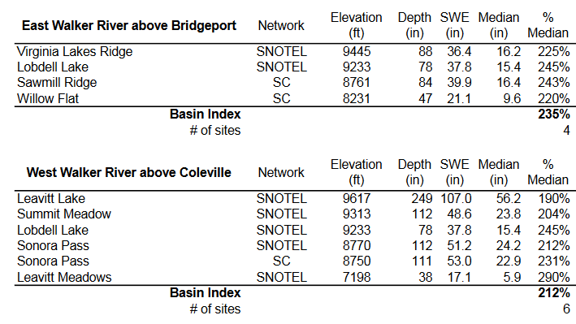

Slide 13
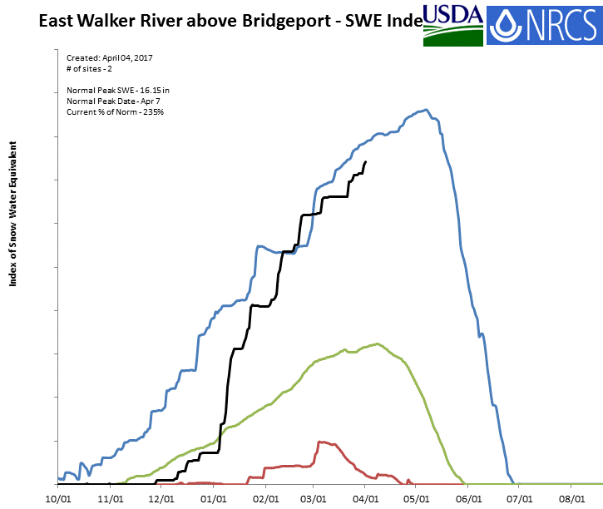
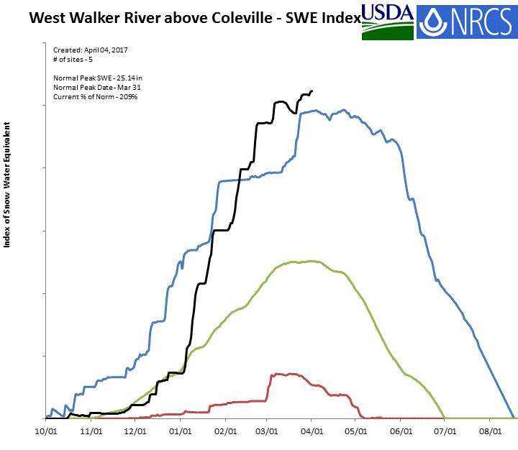
East Walker
https://www.wcc.nrcs.usda.gov/ftpref/states/ut/nv/BI_charts/East%20Walker%20River%20above%20Bridgeport.gif
West Walker
https://www.wcc.nrcs.usda.gov/ftpref/states/ut/nv/BI_charts/West%20Walker%20River%20above%20Coleville.gif

Slide 14
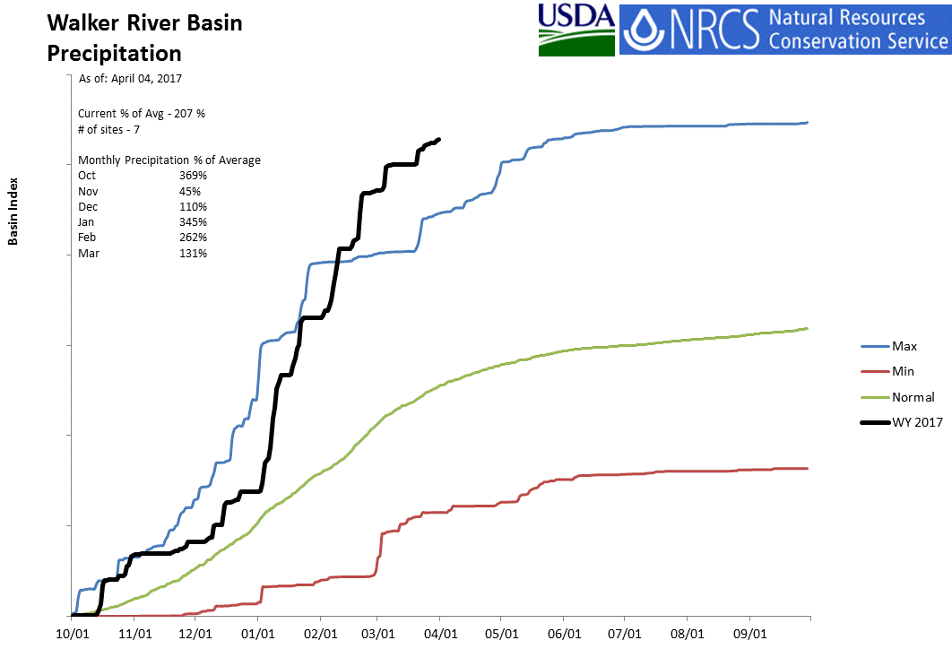
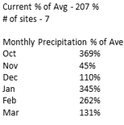
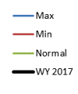

Slide 15
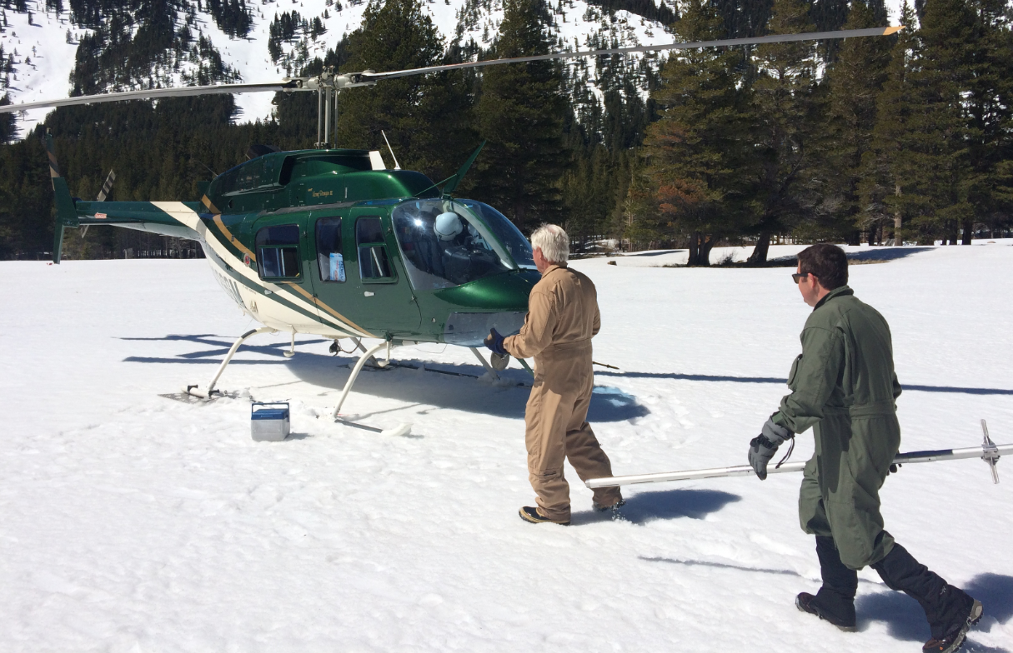
Mar 25-26 Helicopter Mission
Drain maxed out
precip gages at:
Leavitt Meadow (67in)
Monitor Pass (37in)
Ebbetts Pass (87in)
Spratt Creek (57in)
Unplug snow plug in gage at: Leavitt Lake (88in)
Measure snow courses at:
Sonora Pass
Willow Flat
Sawmill Ridge

Slide 16
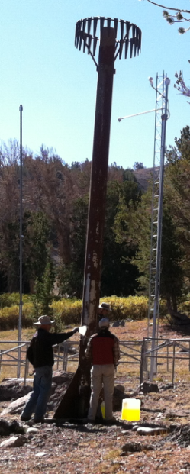
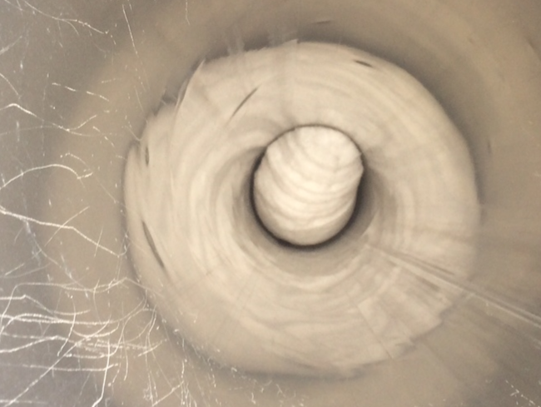
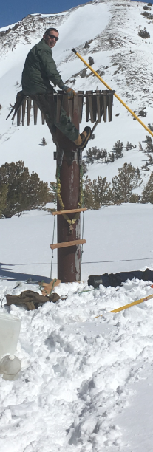
3/27/2017
Leavitt Lake SNOTEL
Precipitation Gage Snow Plug
Mixing in plug caused a rise of ~50in in reading
Leavitt Lake SNOTEL - 28ft tall precipitation gage

Slide 17
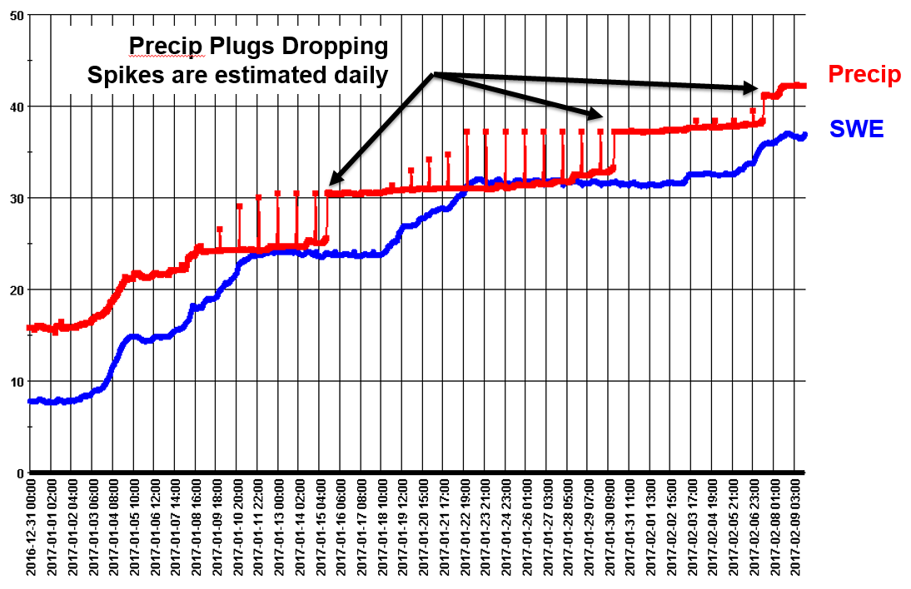
Precipitation Estimates based on SWE Increases

Slide 18
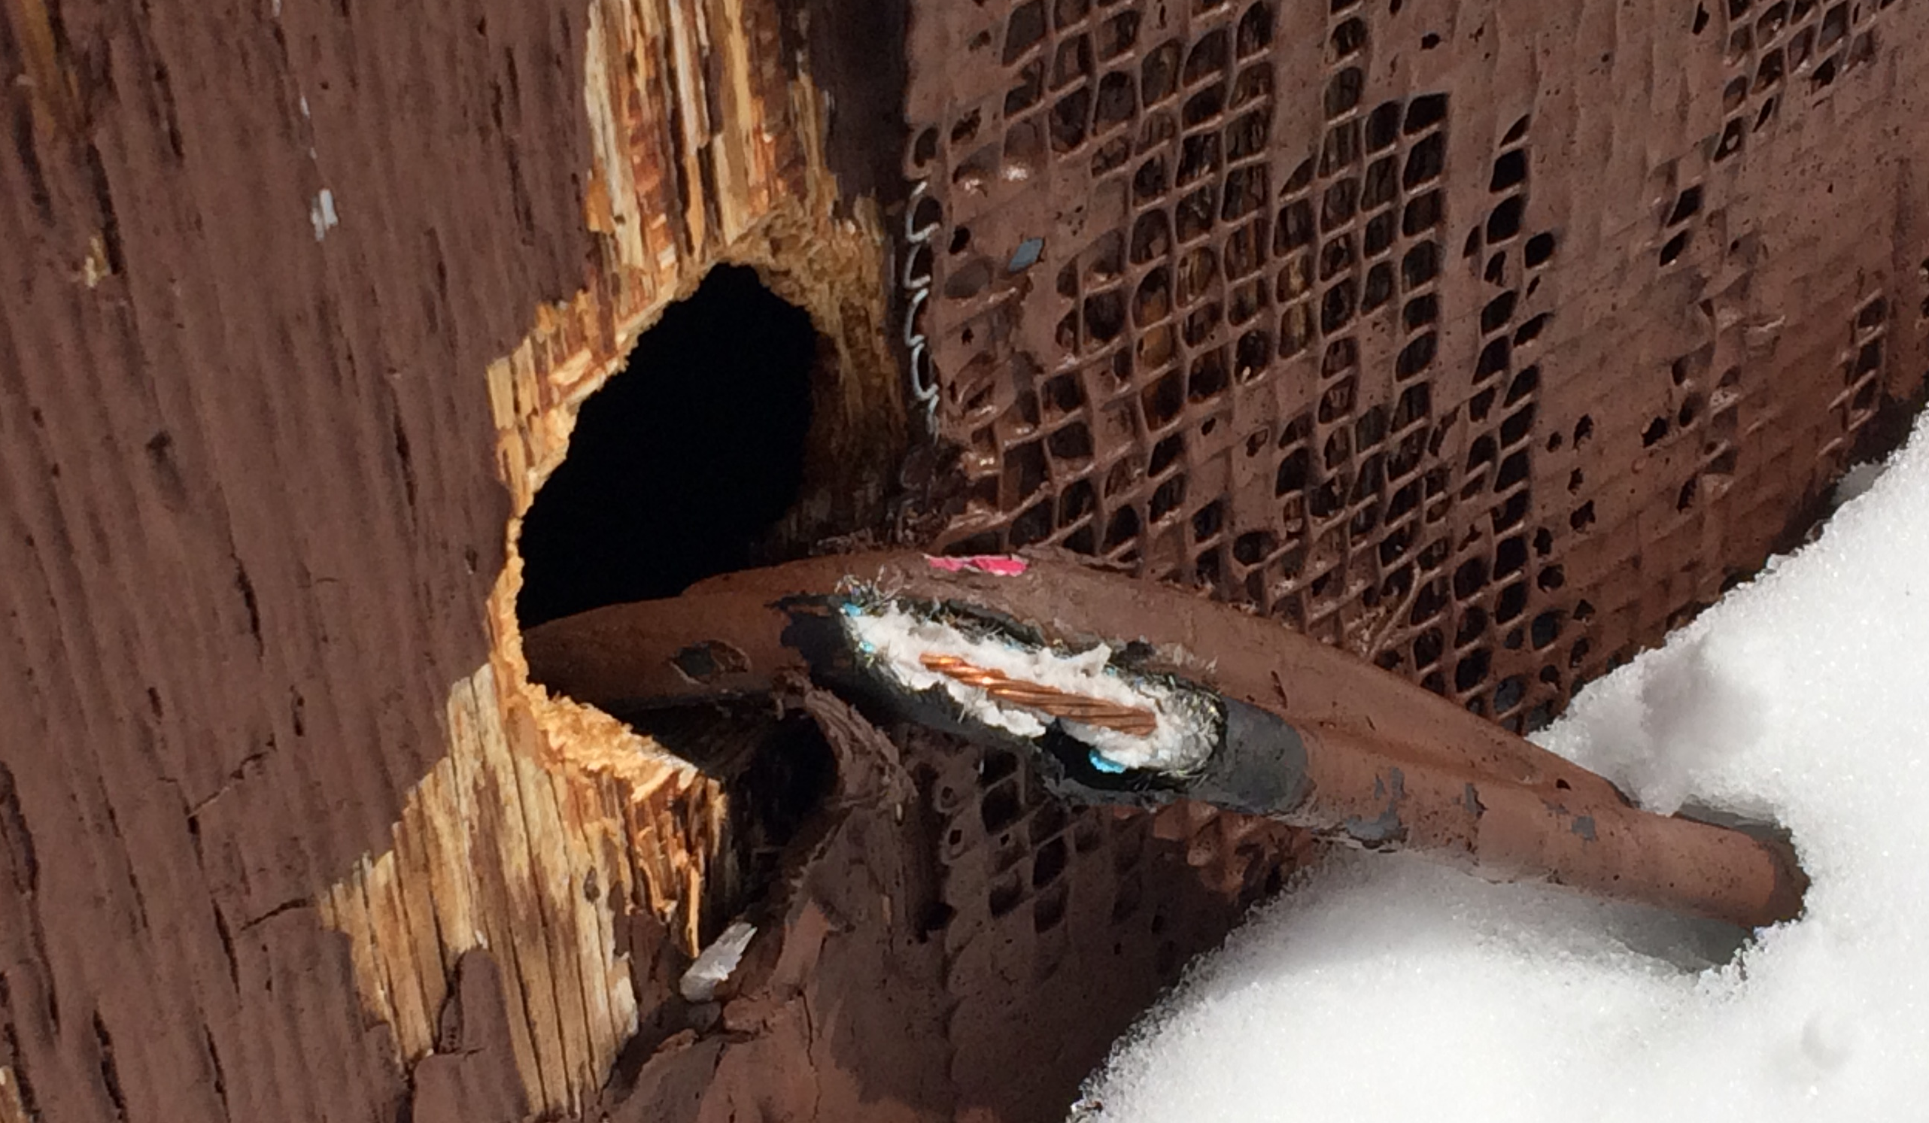
Why is Leavitt Lake not reporting?
We found coaxial cable going to the antenna gnawed on by a critter.
We taped it up, but Murphy’s Law struck and the site shorted and went down.

Slide 19
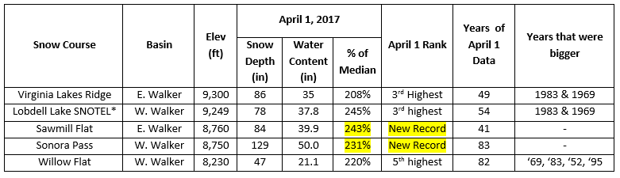
Long-term Snow Course Data Summary
April 1, 2017
*Data prior to 1979 back-estimated by regression with original snow course

Slide 20
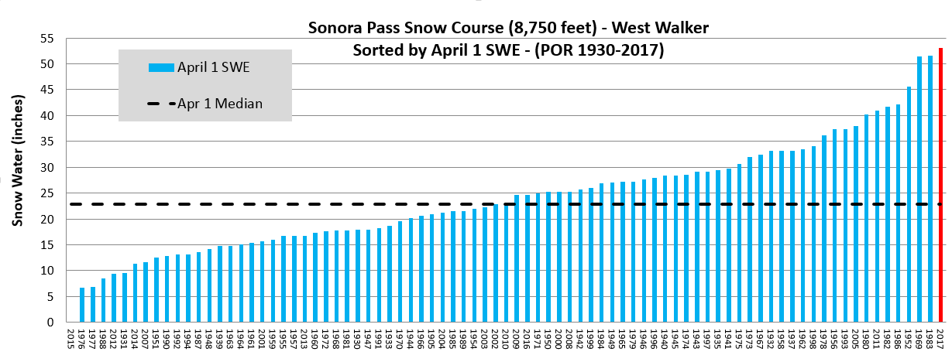
Missing Years: 1934, 1936,1938, 1995, 2006

Slide 21
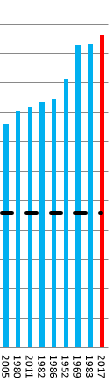
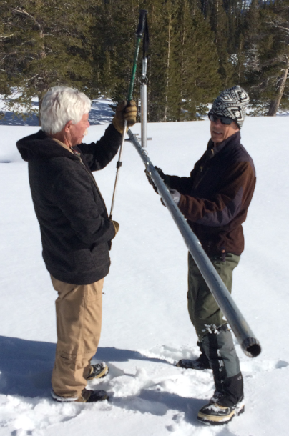

Sonora Pass Snow Course (8,750 feet) - West Walker
Sorted by April 1 SWE - (POR 1930-2017)
John Kelly (El Aero helicopter pilot) and Bob Nault (NRCS Electronics Tech)
Combined snow survey experience +70 years

Slide 22
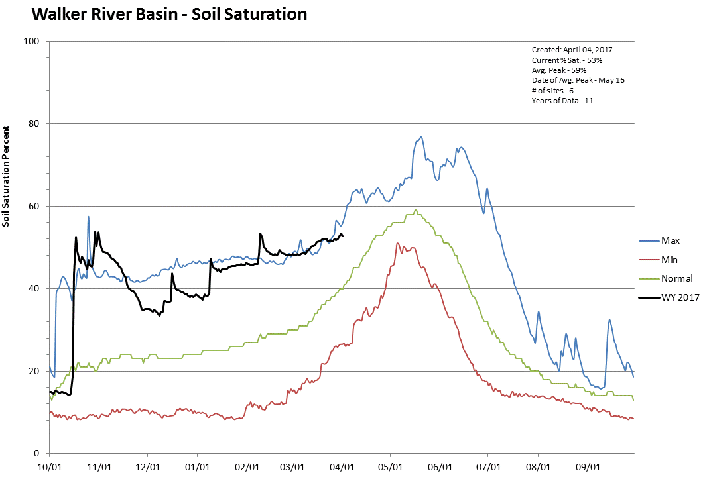
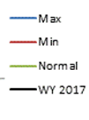

Slide 23
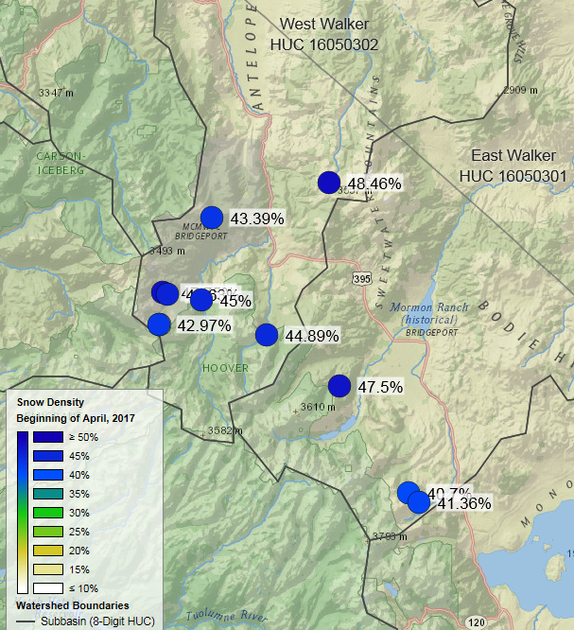
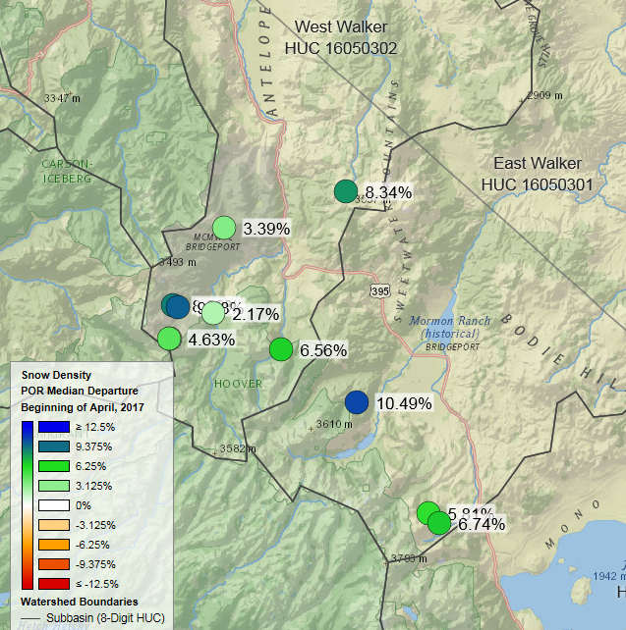
Snow Density
April 1, 2017
Densities are 5-10% higher than normal for April 1. The snowpack is more ripe than normal. Snowmelt will proceed sooner than normal.

Slide 24
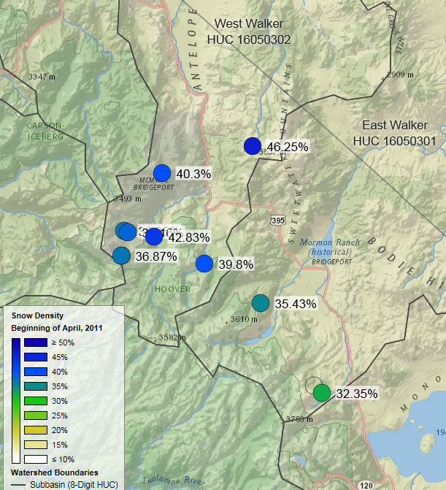
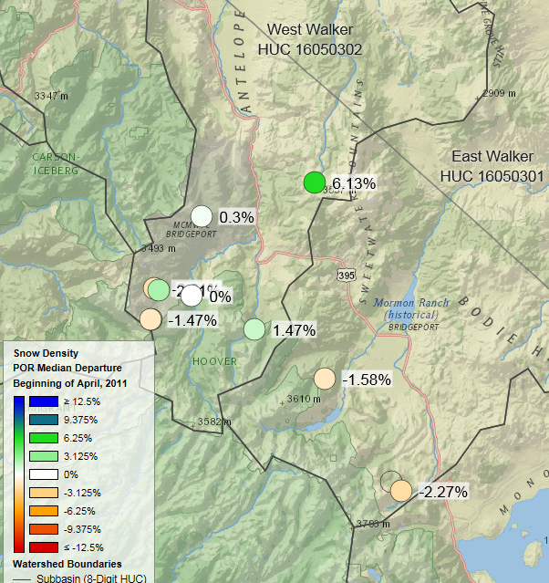
Snow Density
April 1, 2011

Slide 25
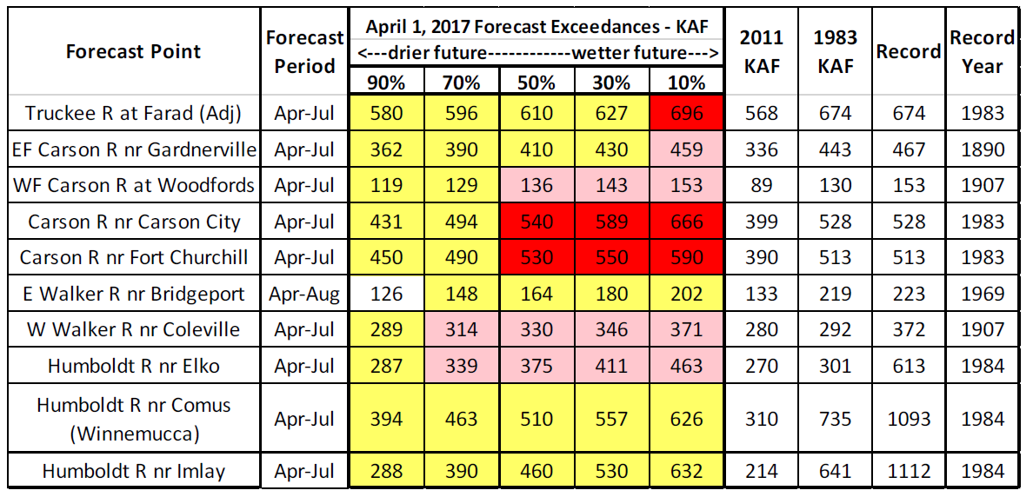
April 1, 2017 NRCS Forecasts
vs.
2011, 1983 & Record Volumes
Jolyne Lea, NRCS Forecast Hydrologist comments on East Walker…
“The East Walker was low in comparison to other forecasts. Taking out the fall precipitation and fall streamflow adjusted the forecast up to the current level (164kaf), and is more in line with historic flows, but it is not as high as the West Walker which is a near record high forecast. The East Walker forecast is close to what was observed in 1995.”

Slide 26
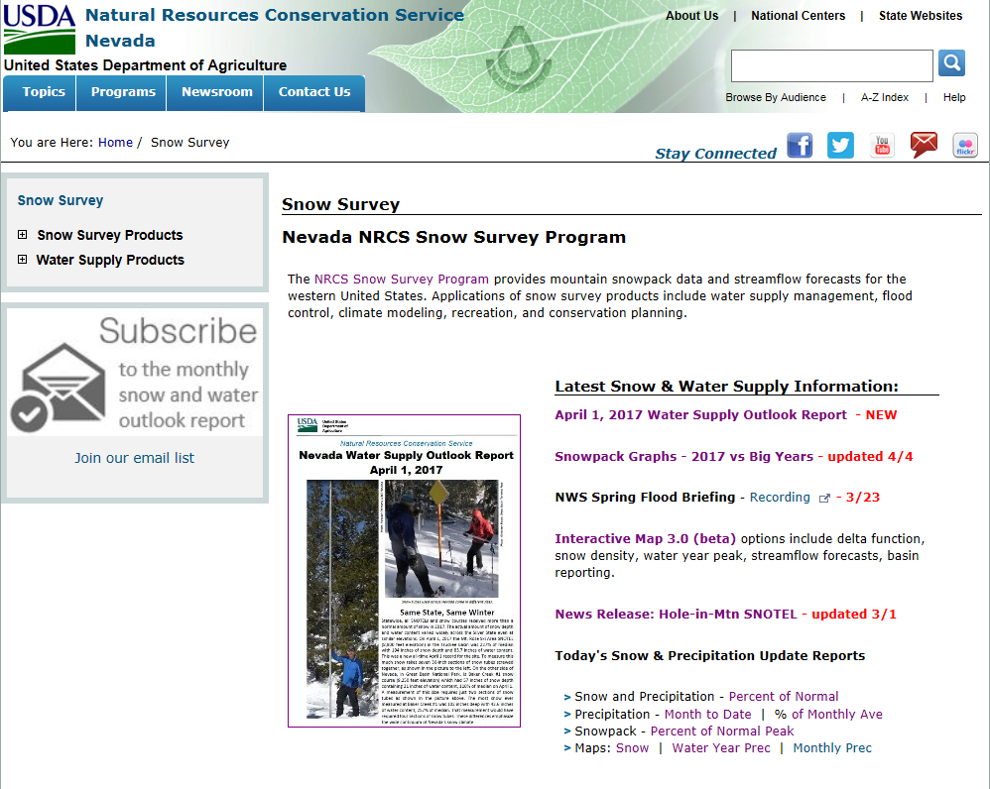
www.nv.nrcs.usda.gov/snow/

Slide 27
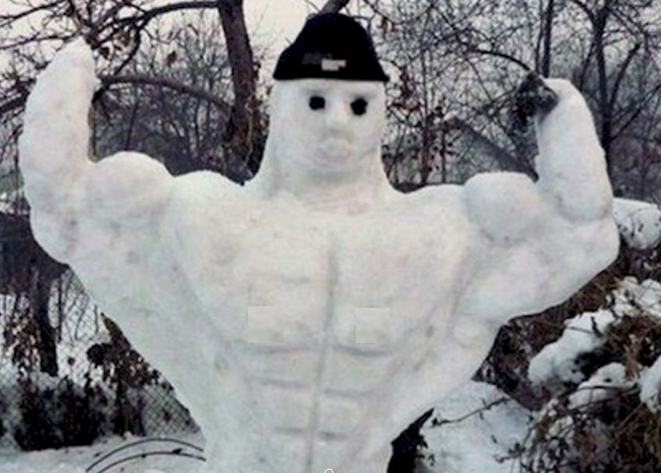
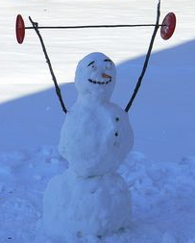
Boom or Bust
2017! 2012-2015 ☹

Slide 28
Bonus slides
not
presented at the meeting

Slide 29
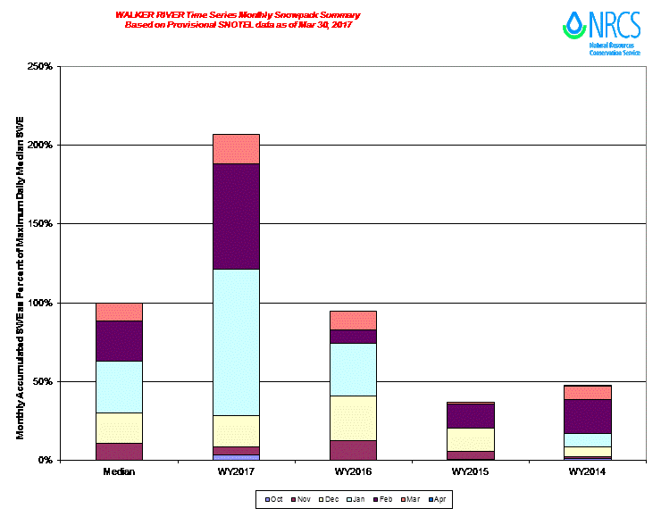

Walker River Monthly Snowpack Summary
Updated April 2, 2017
February = ~2/3 of a winter worth of snow
January = ~1 full winter’s worth of snow

Slide 30
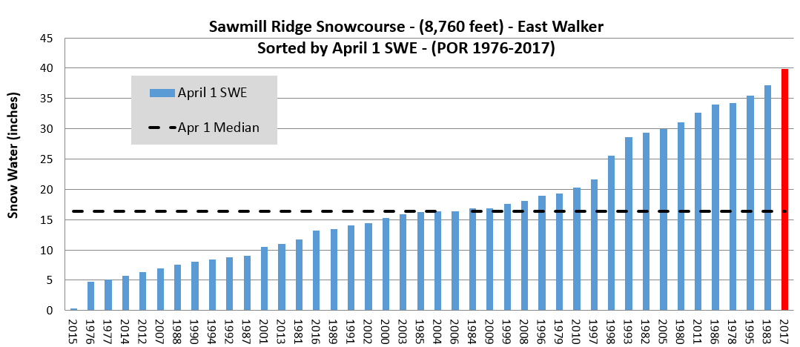
1969 pre-dates Sawmill Ridge

Slide 31
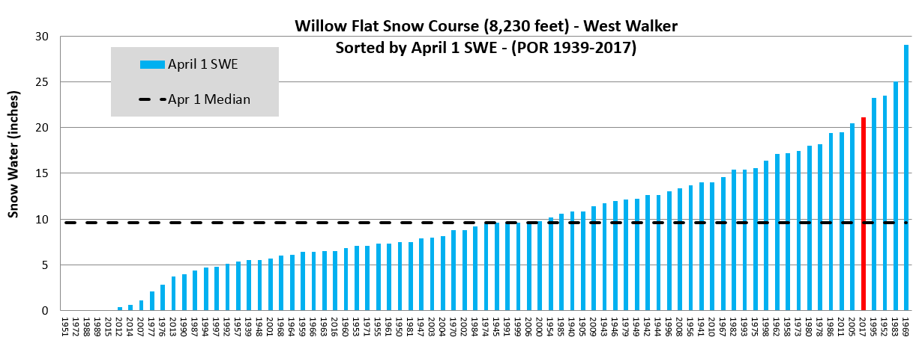
Year SWE
1969 29.0
1983 25.0
1952 23.5
1995 23.2
2017 21.1
5th highest since 1939

Slide 32
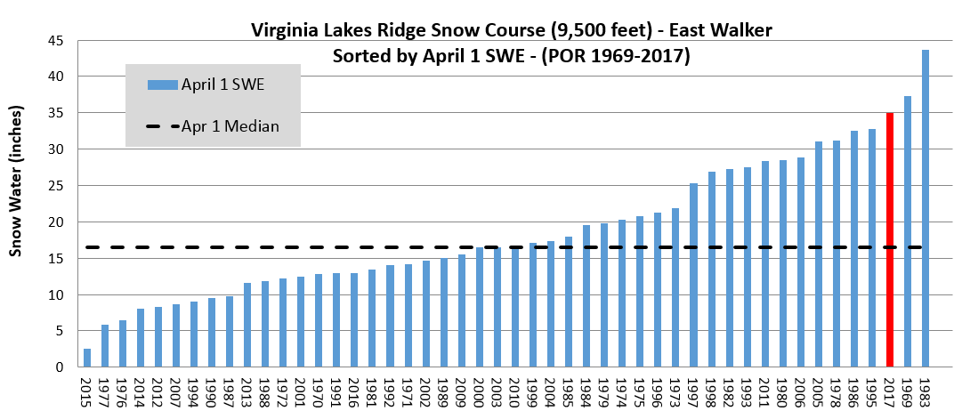
Year SWE
1983 43.7
1969 37.3
2017 35.0
3rd highest since 1969

Slide 33
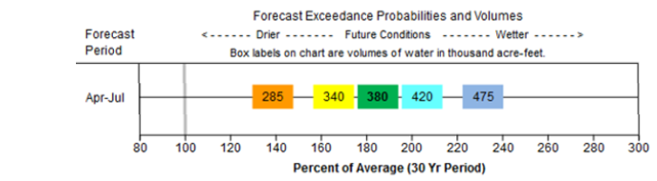
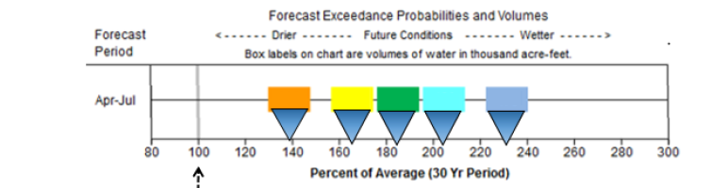
New Forecast Graphic
Numbers inside boxes are KAF for 5 exceedances
Below Average Volume
Average Volume
Above Average Volume
Each colored box represents different exceedance forecasts

Slide 34
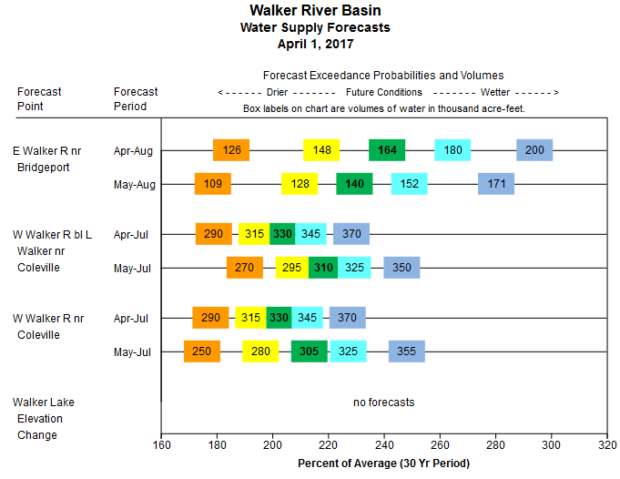
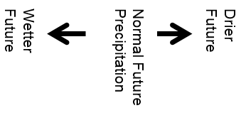

Slide 35


